Slide 1


CALPADS EOY 2
Reporting & Certification
Overview
Data Requirements
Certification Errors
Reports Review
Notes:
Welcome to the End of Year 2 Reporting and Certification Training with CSIS supporting CALPADS.
Introduce self and trainers.
In this session, we’ll provide an overview of the EOY 2 data collection and the data requirements for EOY 2. We’ll discuss common certification errors and provide guidance on the reports review process.

Slide 2
CALPADS Training Road Map
Introduction
System Overview
Basics
Submission: Data Population
File Type: Data Population
Data Collections
Fall 1-2 Reporting and Certification
EOY 1-2 Reporting and Certification
Skill Building
Skill Building
Data Privacy
Data Population
CALPADS Basics
CALPADS Basics (SELPA)
4 Year Cohort
Notes:
The CSIS training model is designed to be segmented to provide organization of specific topics and concise delivery. We aim to provide focused trainings with relevant information and instruction.
- This slide reflects the CALPADS course catalog. In the top we have the various Subject Areas and their respective Programs shown below each one. The first three skill areas contain programs that are the prerequisite for the Data Collection programs and the EOY 2 Reporting & Certification is part of the EOY 1-2 Reporting and Certification program, which you are attending today. We also have the Skill Building program consisting of courses which are available in self-paced format.

Slide 3


Target Audience
Data Coordinator
Administrators
Notes:
EOY 2 Reporting & Certification is a review the submission requirements, certification process and snapshot reports involved in EOY 2. As such this training is intended for Data Coordinators, those doing the daily work of CALPADS. Administrators and data stewards are encouraged to attend as well. If you are new to CALPADS, we strongly recommend that you attend the relevant data population training sessions to learn more about field specifications and submission details for EOY 2 file types.

Slide 4




Objective
Identify
Perform
Resolve
Analyze
key data and stakeholders in preparation of the EOY 2 submission
the EOY 2 submission process based on an internal schedule considering staff availability and competing priorities
certification errors using analytical mindfulness and review reports for completeness and reasonability
Critical Thinking
certification reports to assess the flow of data across the ecosystem and evaluate how well data is leverage in informed decision making
Data Leadership &
Coalition Building
Project Management
Data Leadership &
Critical Thinking
Notes:
Today’s training has been developed with specific objectives in mind that highlight essential skills needed during the CALPADS Submission process.
By the end of this session, participants will be able to:
Identify key data and stakeholders in preparation of the EOY 2 submission (Data Leadership & Coalition Building)
Perform the EOY 2 submission process based on an internal schedule considering staff availability and competing priorities. (Project Management)
Resolve certification errors using analytical mindfulness and review reports for completeness and reasonability. (Critical Thinking)
Analyze certification reports to assess the flow of data across the ecosystem and evaluate how well data is leverage in informed decision making (Data Leadership & Critical Thinking)

Slide 5

Agenda
Overview
Data Collected
Certification Errors
Reports Review
Wrap-Up
Notes:
Here is the agenda for this training. We will discuss the following:
An overview of the EOY 2 submission.
Discuss the data collected from the Course completion, CTE and work-based learning submissions.
Look at the most common certification errors.
Review the EOY 2 Reports.
Lastly, wrap up The session with reminders and resources.

Slide 6

Overview
Discuss the big picture of EOY 2 submission
Notes:
Let’s jump into our overview of EOY 2, where we will look at the data submission from a big picture perspective.

Slide 7

  Key Dates
Snapshot
starts
May 5, 2026
Certification Deadline
Aug. 17, 2026
Error Free & Review Reports Aug. 3, 2026
The End of Year reporting period is July 1, 2025– June 30, 2026
Notes:
Our goal is to help LEAs build their local capacity. Therefore
The expectation is for each LEA to resolve all fatal errors by August 3rd and Approve by August 17th
The EOY snapshot reports will generate on — May 5th
The EOY zero error milestone is — August 3rd
The EOY submission window deadline is — August 17th
Also, these dates can change so it is best to check the CDE’s calendar using the link on this slide.
Minimize data cleanup in CP. If you are cleaning data (resolving validation and CDDs) for more an 2 weeks in CALPADS, that is an indication there are local issues that need to be addressed. CDE will always reconsider the timelines if the system is not performing as expected.

Slide 8
Data Submission Windows for 2025-26
Census Day
Certification Deadline
Final Deadline
Initial ELPAC Testing Window opens
July 1, 2024
Oct 1, 2025
Dec 12, 2025
January 23, 2026
Cohort Pull
August 17, 2026
CAASPP Testing
1/20 to 6/30/2026
Fall 1 Submission
ELPAC Summative Testing
Fall 1
2/2 to 5/31/2026
Cohort Processing - ongoing
2025
Nov
Dec
2026
Feb
Mar
Apr
May
Jun
Jul
Aug
Sep
Oct
Jan
AY 26-27
Fall 2 Submission
GAP
EOY Submissions
EOY 1
Fall 2 Deadline
Start of Submission
Certification Deadline EOY 1
Final Deadline EOY 1
Final Deadline EOY 2
Amendment Windows
Feb 27, 2026
May 5, 2026
July 17, 2026
July 31, 2026
August 17, 2026
Notes:
This slide outlines the full data submission calendar for the 2025–26 year. However, we will be focusing on on the End‑of‑Year submissions.
The EOY submissions officially open on May 5, 2026. That’s the point when the snapshot revisions for EOY are activated and reports reflect counts based on currently uploaded data. Considering the shorter EOY 2 deadline, LEAs are encouraged to start uploading relevant data to CALPADS as data is available and clear any Data Discrepancy errors.
EOY 2 has a certification deadline on July 17, followed by its final deadline on July 31, which requires SELPA approval.
EOY 2 has a single Final certification deadline on August 17, and there is no amendment window for EOY 2.

Slide 9

End of Year 2
Course Completion
Career Technical Education
Work-Based Learning
One -Year Graduates
Provide course section completer counts by State Course Code completed during the current academic year
Provide counts of CTE participants, and completers for Perkins reporting
Provide counts of student completion of specific work-based learning programs
Provide count of students who graduated during the academic year, as well as other school completers

Slide 10



The Big Picture
Federal System
EDFacts file submissions and the Consolidated State Performance Report (CSPR)
Migrant Student Information Exchange (MSIX) - Course Completion, Carnegie Unit
Titles VI & IX reports for the Civil Rights Act of 1964
Carl Perkins V Reporting
(CTE Participants and Completers)
Section 1418 of the Individuals with Disabilities Education Act (IDEA) 2004 of the federal statutes (Title 20 USC Chapter 33), Individual with Disabilities Education Act (IDEA)
ESSA sections 1112, 2103,4203
WIOA sections 148,159418,422
State System
CALPADS
CDSS
TOMS
DataQuest
California Dashboard
Ed-Data
Local Systems
Enrollment
Student demographics
Student programs (homeless, migrant ed, FRPM eligible, pregnant and parenting, etc)
Career Technical Education (CTE)
Students with Disabilities (SWD)
Staff Demographics
Course Section attributes
Student Course Completion
Work-based Learning
Notes:
Before we move into the finer details of EOY 2 reporting through various file types, let’s take do a quick 10,000 foot overview of the EOY 2 submission and see the big picture process at play here.
Your local Student Information System (SIS) stores your day-to-day school data, including information on student enrollment, demographics, CTE, SWD, Credentialed Staff demographics and courses, and student course enrollments.
This data is submitted to CALPADS as well as other statewide systems like the Testing Operations Management System (TOMS) and the California Department of Social Services (CDSS).
Data is pulled directly from CALPADS for publishing on Data Quest and the California School Dashboard.
California State and the CDE are in turn compelled to report specific data groups to the federal government, and all requirements are listed in the Federal System bubble on the slide. These are requirements throughout all data submissions throughout the year, not just EOY 2, but are quite relevant in EOY 2.
Federal reporting includes migrant student information, course completion and Carnegie units earned, Carl Perkins CTE participant and completer info, SWD, Every Student Succeeds Act (ESSA), and Workforce Innovation Opportunity Act (WIOA) data.

Slide 11
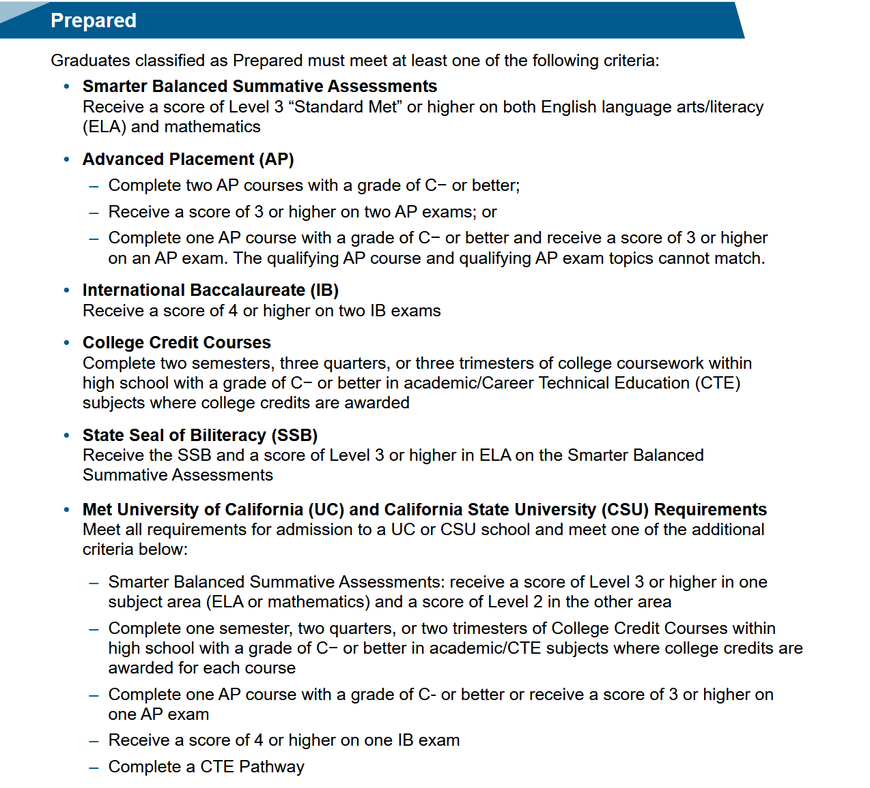
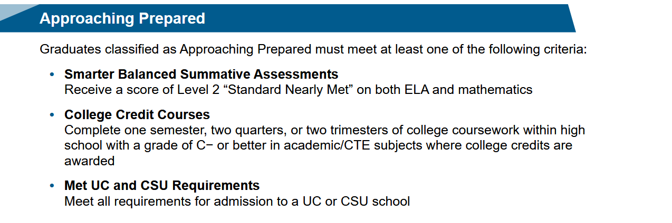

CCI Measures of College Readiness*
Notes:
We mentioned the California School Dashboard as part of the state systems reporting. In the California School Dashboard, there are various indicators which measures school performance. The College/Career indicator is particularly relevant to EOY 2. The CCI indicator shows how well LEAs and school are preparing students for likely success after graduation. There are two measures to consider with this indicator: college readiness and career Y readiness.
This slide contains the CCI Measures for College readiness. Displayed are the criteria to determine whether the relevant data you submit to CDE indicates College Prepared, Approaching Prepared, or Not Prepared. Only graduates can be classified as “Prepared” or “Approaching Prepared”. For LEAs to demonstrate success on this measure, high school graduates must meet at least one of the criteria in the “Prepared” or “Approaching Prepared” levels.
The criteria outlined in red represent data that is pulled directly from CALPADS. Particular to EOY 2, College Credit Courses and UC/CSU a-g requirements are provided in CRSC and SCSC files; CTE Pathway completion is provided in the SCTE file.
The criteria outside of the red outline come from non-CALPADS sources like CAASPP, AP/IB Exams, Summative assessments, and so on.
https://www.cde.ca.gov/ta/ac/cm/documents/dbguidecci23.docx

Slide 12
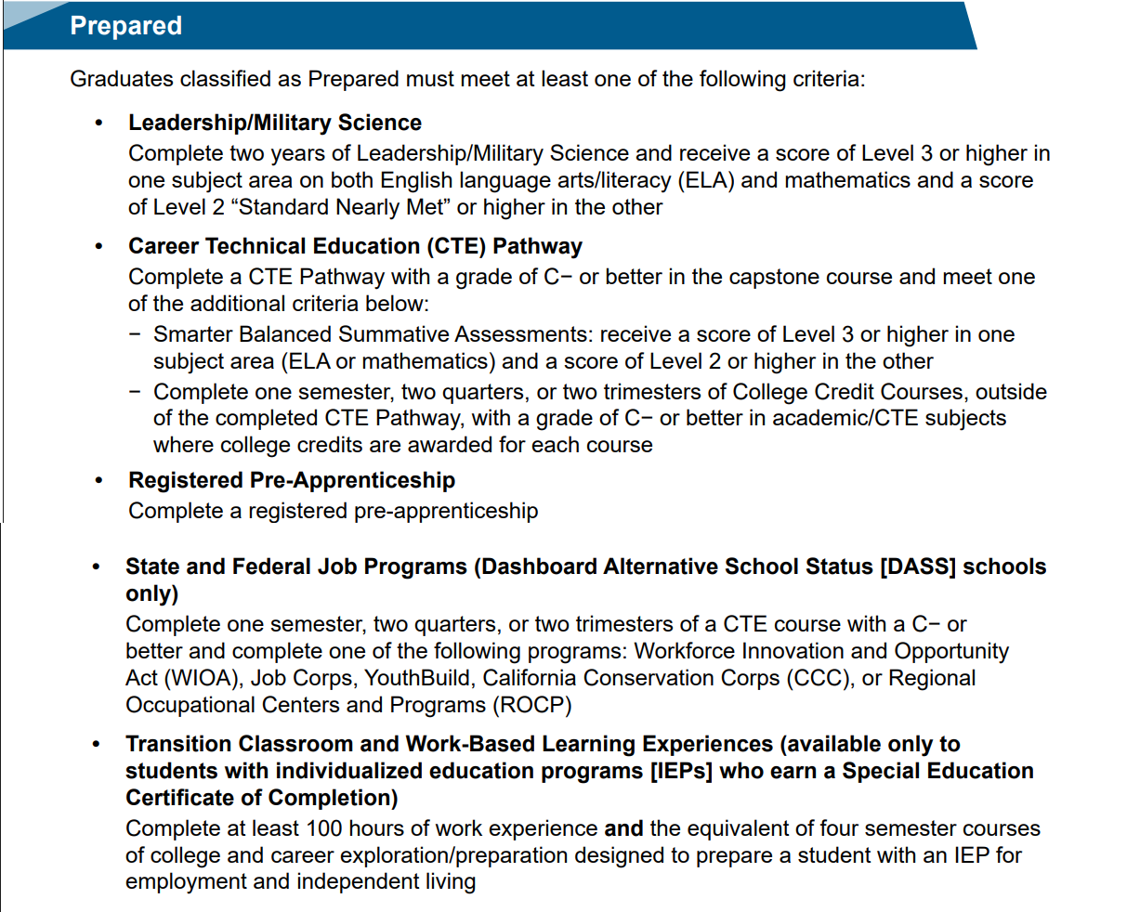
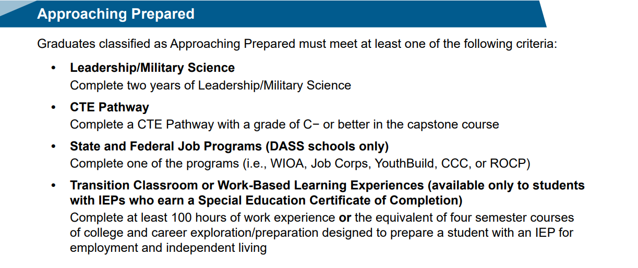

CCI Measures of Career Readiness*
Course Completion
Student Career Technical Education
Work-based Learning
Notes:
This slide contains the CCI Measures for Career readiness. Displayed are the criteria to determine whether the relevant data you submit to CDE indicates Career Prepared, Approaching Prepared, or Not Prepared. Only graduates can be classified as “Prepared” or “Approaching Prepared”. For LEAs to demonstrate success on this measure, high school graduates must meet at least one of the criteria in the “Prepared” or “Approaching Prepared” levels.
The criteria outlined in red represent data that is pulled directly from CALPADS. Particular to EOY 2, Leadership/Military Science courses and CTE courses are reported in CRSC and SCSC records, and Transitional Classroom and Work-Based Learning Experience is reported in WBLR records. Leadership and Military Science includes State Course Codes 9373 (Leadership/Military science) and 9374 (Junior Reserve Officers Training Corps (JROTC)). It is important to be aware of the data elements you submit to CALPADS in EOY 2 that will be relevant to the CCI on the CA School Dashboard.
https://www.cde.ca.gov/ta/ac/cm/documents/dbguidecci23.docx

Slide 13
DASHBOARD College/Career Indicator Clarification
College Credit Courses: Courses which students have taken and completed independently, which have no association or oversight by the school, will not contribute to a school’s CCI.
2023 Dashboard Technical Guide: College/Career Indicator (CCI) - Page 8 https://www.cde.ca.gov/ta/ac/cm/dashboardguide23.asp
CTE Pathway Criteria: To be considered “prepared” on the CCI using the CTE Pathway criteria, students must…
complete the Pathway capstone course with a grade of C- or better AND
Score Level 3 or higher in one Smarter Balanced Summative Assessments subject area (ELA or math) and Level 2 or higher in the other, OR
Complete one semester/two quarters/two-trimesters of College Credit Courses with a grade of C- or better in academic/CTE subjects where college credits are awarded for each course.
Notes:
Clarification on College Credit Courses: Some LEAs are submitting college courses that students took and completed independently, and which have no association or oversight by the school. Since the CCI is a measure of the school’s effectiveness in preparing students for college or career, the CDE clarifies in the technical guide that the completion of such courses will not contribute to a school’s CCI.
Clarification on CTE Pathway Criteria: To be considered “prepared” on the CCI using the CTE Pathway criteria, students must complete, the capstone course of the Pathway, with a grade of C- or better AND:
Score Level 3 or higher in one Smarter Balanced Summative Assessments subject area (ELA or math) and Level 2 or higher in the other, OR
Complete one semester/two quarters/two-trimesters of College Credit Courses with a grade of C- or better in academic/CTE subjects where college credits are awarded for each course.
For the CTE Pathway criteria, students cannot receive college credit for any of the courses within the completed CTE Pathway. Students must complete the college credit courses outside of the CTE Pathway

Slide 14


EOY 2 Reporting Survival Kit
User Roles Needed
CALPADS Documentation
Data Population
  Student Search
  SENR (Edit and View)
  SCTE (Edit and View)
  CRSC (Edit and View)
  SCSC (Edit and View)
  SDEM (Edit and View)
  WBLR (Edit and View)
  WBLR Extract
Viewing Reports
  EOY Reports
User Manual
CALPADS Code Sets
File Specifications Form
Error List
Data Guide
Valid Code Combinations
Notes:
To successfully report your student data in CALPADS, LEAs need the proper User account roles assigned. The roles needed to populate data and view reports in EOY 2 are contained on the lefthand side of this slide. [They are: student search, SENR Edit and View, SCTE Edit and View, CRSC Edit and View, SCSC Edit and View, SDEM Edit and View, WBLR Edit and View, and WBLR Extract permissions. To view EOY 2 reports, users will need EOY 2 Reports permissions.]
LEAs should also be aware that there are excellent reference documents available to download for guidance on different aspects of CALPADS reporting.
The CALPADS User Manual contains all essential information for CALPADS users to make full use of the system. It includes a description of the system functions and capabilities, contingencies and alternate modes of operation, and step-by-step procedures for system access and use. It also serves as a gateway to additional state compliance resources, submission and report analysis tools.
The CALPADS Code Sets contains the current code values in CALPADS for fields with the coded value data elements.
The CALPADS File Specifications or CFS provides data submission requirements at the individual field or file specification level, as well as information on CALPADS file processing methods.
The Error List contains descriptions and suggested resolutions for each error generated when submitting data to CALPADS.
The CALPADS Data Guide provides general guidance for local educational agencies (LEAs) regarding the collection and submission of data for CALPADS. The data guide is currently a bit outdated, and users may be better suited turning to the User Manual.
The Valid Code Combinations document lists codes that can only be used in specific combinations with other fields/elements, as enforced by validation errors.
And the Retired Code Mapping Guide provides a list of state curse codes that were retired from CALPADS during a codes transition in the 2018-19 school year, and their new associated course codes.

Slide 15
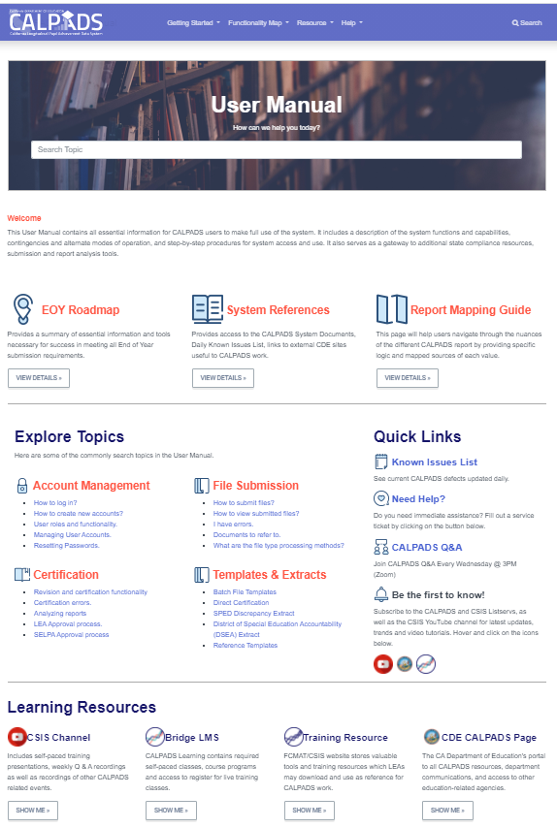
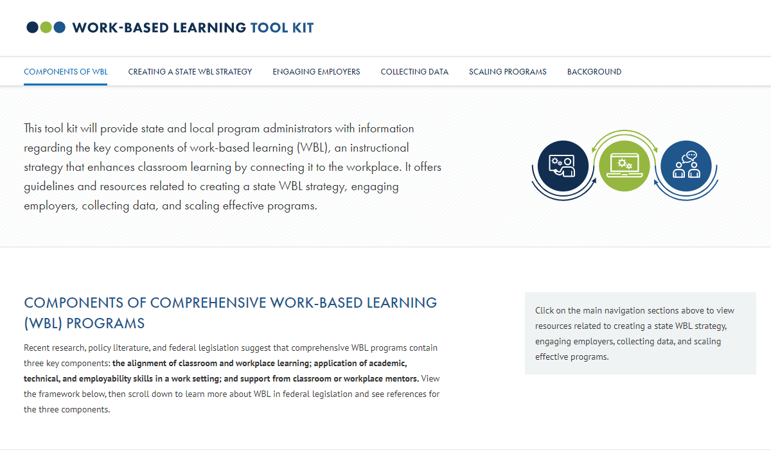
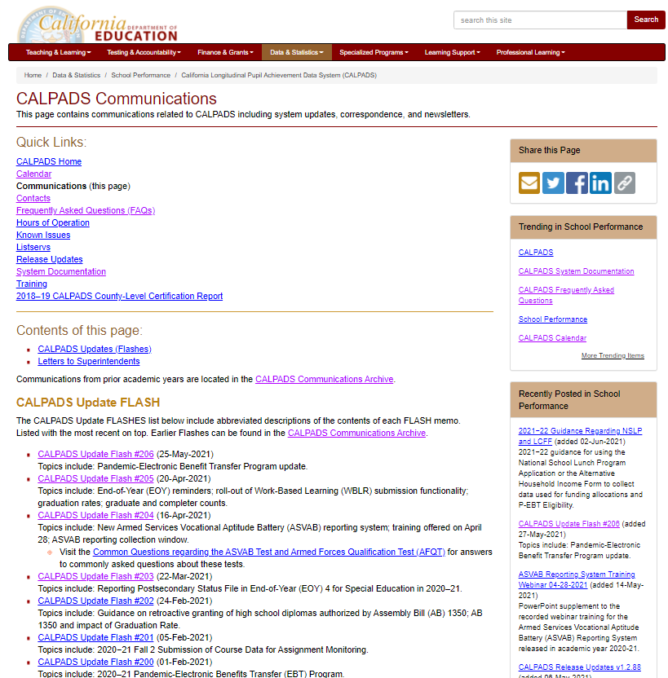
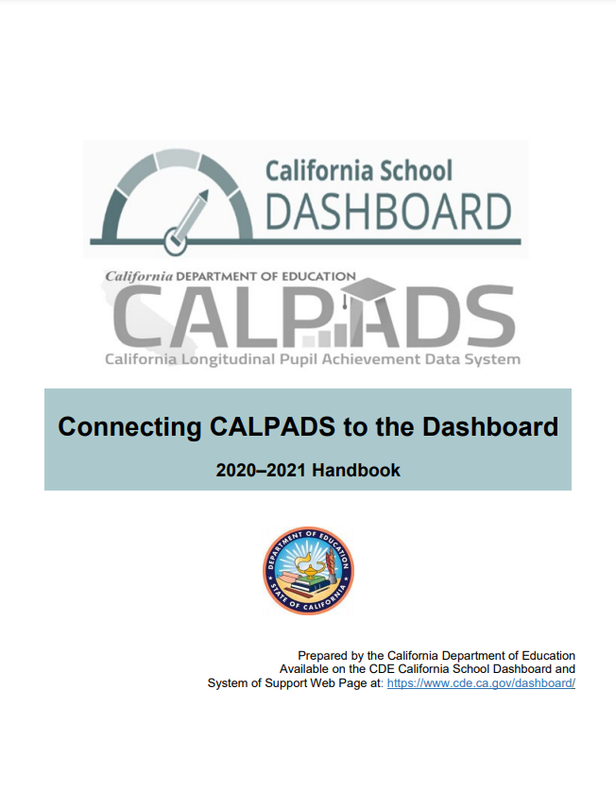
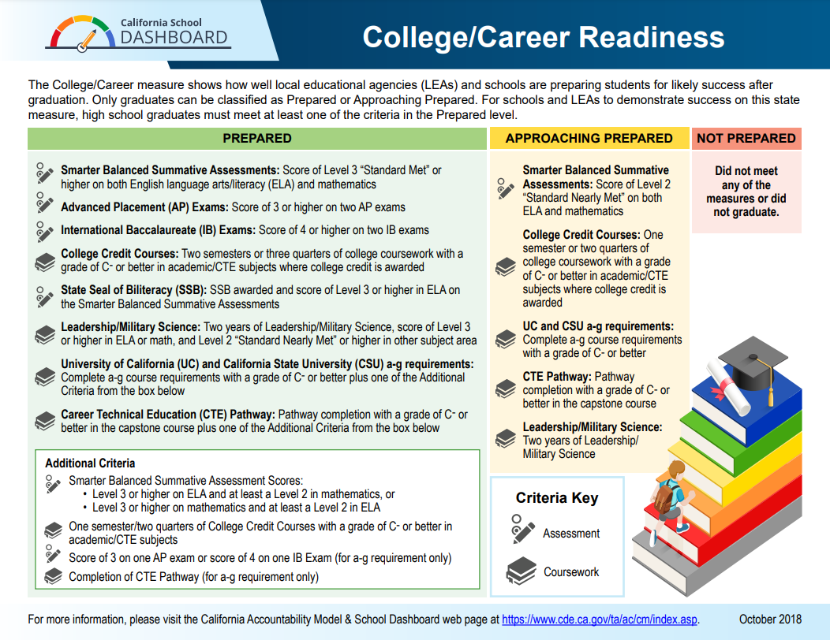
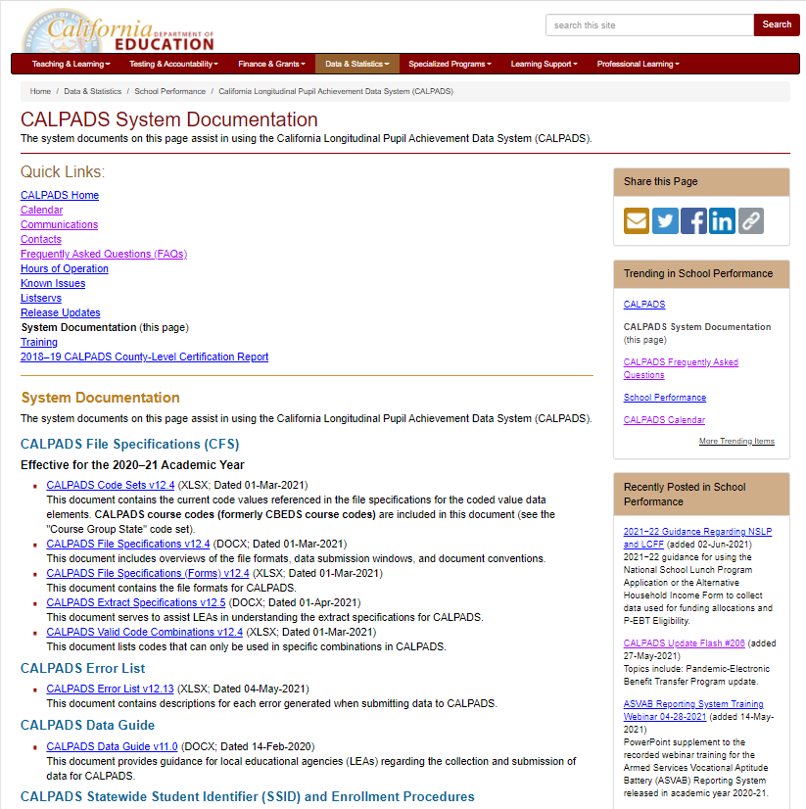
Resources
Notes:
Developing referential knowledge of CALPADS documentation will increase your capacity as a data coordinator allowing you to resolve problems and answer questions independent of support. So, lets look at the EOY 2 resources.
CALPADS User Manual: https://documentation.calpads.org/
CALPADS System Documentation Page: https://www.cde.ca.gov/ds/sp/cl/systemdocs.asp
CALPADS Communications: https://www.cde.ca.gov/ds/sp/cl/communications.asp
https://www.cde.ca.gov/ds/sp/cl/calpadsupdflash184.asp
CA School Dashboard Handbook (https://www.cde.ca.gov/ta/ac/cm/documents/caldashhandbook21.pdf): https://www.cde.ca.gov/ta/ac/cm/
US Dept of ED. Work–based learning tool kit: https://cte.ed.gov/wbltoolkit/collecting.html.

Slide 16

Data Collected
Discuss data requirements
Notes:
Let’s look at EOY 2 from a big picture perspective.

Slide 17
EOY 2 Data Collected
Student Enrollment (SENR)
a-g Requirements
Credits
Grades
CTE (SCTE)
Pathways
Completers
State Course codes
Student Course Completion (SCSC)
Postsecondary Articulated Course Indicator
Course Completion (CRSC)
Course Attributes (AP/IB, College Credit Course, Met UC/CSU Req, HQ CTE)
Work-based Learning
Carnegie Units
(SEIDs)
Work-Based Learning Types
Internship Attributes
Hours
Teachers Demographics (SDEM)
Seal of Biliteracy, Golden State Seal, A–G Completion
CTE Participants
One-Year Graduation and Completers
4-year Cohort
Student Enrollment (SENR)
Files Submitted
Course Completion (CRSC)
Student Crs. Completion (SCSC)
Student CTE (SCTE)
Work-based Learning (WBLR)
Staff Demographics (SDEM)
Site Staff
Staff Involved with Submission
Program staff
CTE
Site Administrators
Student System Support Staff
🖌 NOTE: Courses completed are not compared to course enrollment reported during Fall 2
Notes:
The file types required for EOY 2 all use replacement processing where any record in the CALPADS ODS with the same operational keys are replaced on upload. The one exception is the Staff Demographic file, which uses the more flexible effective date processing method.
SENR records must be updated in EOY 2, and should be updated prior to uploading WBLR records. CALPADS will pull data on the state seal of biliteracy, golden state seal, and A-G completion from the SENR record.
The SDEM file is used to submit demographic data about credentialed staff members who were actively employed at any time during the current academic year. An update of the SDEM file is typically submitted to include those teachers of record who were not active during the fall 2 reporting period.
The CRSC file is used to submit course completion data, including State course codes and course attributes, for all departmentalized courses that students completed during the academic year.
The SCSC file format is used to submit student course section data, including credits, grades, Carnegie units, CTE, and a-g requirements, for departmentalized course sections that students completed during the academic year, and for which they received a grade.
The SCTE file format is used to submit career technical education (CTE) information about a student. Specifically, students are identified as CTE pathway completers if they completed a CTE pathway within the current academic year. The high Quality CTE Indicator is used to designate High Quality CTE courses only. These staff are credentialed to teach career tech ed.
The WBLR file is used to submit work-based learning data that will provide additional opportunities for students to demonstrate their preparedness for college/career through the College/Career Indicator (CCI) on the California School Dashboard.
Reminders:
Course completion for End of Year 1 is not compared to Course enrollment from Fall 2
Course completion is only required for departmentalized classes in grades 9-12 and optional for grades 7-8
CTE Completers are determined using the SCTE file
SEIDs submitted in Course Section Completion (CRSC) records are checked to make sure a corresponding Staff Demographic (SDEM) record exists in CALPADS (unless SEID is 9999999999)
Do not submit the SASS file. Staff Assignment data is not required for EOY and submitting a file may wipe out previously submitted data
Staff Involved:
Site Staff
Program Staff
CTE Staff
Site Administrators
Student System Support Staff

Slide 18
Record Relationships
1
Staff Demographics
1
Student Enrollment
SEID
2
SSID
Course Section
Completion
SSID
2
Work-Based Learning
Course Section ID
Course Pathway Code
3
4
Student Course Section Completion
Student Career Technical Education
Order of submission
Notes:
There is a recommended sequencing to the files you submit to CALPADS in EOY 2, based on the relationships between records.
The SDEM, CRSC, SCSC, SCTE and WBLR are required for EOY 2. In EOY 2, you will want to ensure that the SENR and SDEM records are up to date in CALPADS before submitting any of the other file types.
SENR records will need to be updated to reflect student data at the end of the school year.
SDEM records will need to be updated so that all teachers instructing students are reported during the academic year. If you make it a practice to keep SDEM records at your LEA current in CALPADS on an ongoing basis throughout the school year, this will be a quick step.
- Once the staff demographic submission is complete the CRSC should be submitted and posted. The SEID from the SDEM ties the teacher to the Course section.
- After the courses have been posted in CALPADS the SCSC file can be submitted and posted. The SCSC records are tied to individual course sections by a shared course section ID.
The SCTE file is submitted to identify completers of specific pathways. The Course pathway code ties SCTE records to CRSC records to validate that CTE students received the correct pathway curriculum.
Finally, the WBLR file may be submitted independently of other EOY 2 file types. However, an enrollment record for the School of Attendance during the Academic Year reported must exist for the student.

Slide 19
File Reporting Matrix
Details School types and grade levels expected to report specific files related to EOY 2
School Type | CRSC/ SCSC | SDEM | CTE/ WBLR
Traditional (non-educational options schools) | Y | Y | Y
District Level Programs (Independent Study and Home Hospital Programs) | P | P | P
County Community | P | P | Y
District Community Day | P | P | Y
Youth Authority Schools (currently called Division of Juvenile Justice) | P | P | Y
Juvenile Court Schools | P | P | Y
Continuation High Schools | P | P | Y
Opportunity | P | P | Y
Alternative Schools of Choice | Y | Y | Y
State Special Schools | Y | Y | Y
Home and Hospital Schools(5) | P | P | Y
Department of Development Services | N | N | N
Department of State Hospitals | N | N | N
Special Education Consortium | P | P | Y(1)
Special Education | P | P | Y(1)
Non-Public School Group (0000001) (2) | N | N | N
Private School Group (0000002) (2) | N | N | N
ROP/ROC(4) | N | N | N
Grade Levels | CRSC/ SCSC | SDEM | CTE/WBLR
Infants - IN | N | N | N
Prekindergarten - PS | N | N | N
Kindergarten - KN | N | N | N
First Grade - 01 | N | N | N
Second Grade – 02 | N | N | N
Third Grade – 03 | N | N | N
Fourth Grade – 04 | N | N | N
Fifth Grade – 05 | N | N | N
Sixth Grade – 06 | N | N | N
Seventh Grade – 07 | P | P | P
Eighth Grade – 08 | P | P | P
Ninth Grade – 09 | Y | Y | Y
Tenth Grade – 10 | Y | Y | Y
Eleventh Grade – 11 | Y | Y | Y
Twelfth Grade – 12 | Y | Y | Y
Adult – AD | N | N | N
Legend:
Y = Required: Schools are expected to submit data and will receive validation errors if data are not submitted.
N = No: Schools should NOT submit data.
P = Permitted: Schools are permitted, but not expected to submit data
Notes:
Remember for specifications refer to the CALPADS CFS, https://www.cde.ca.gov/ds/sp/cl/documents/cfsv124-20210301.docx.
These tables identify which schools and grade levels will be expected or required to report which EOY 2 files.
Table Value Legend:
Y = Required: Schools are expected to submit data and will receive validation errors if data are not submitted.
N = No: Schools should NOT submit data.
P = Permitted: Schools are permitted, but not expected to submit data
Cover Traditional Schools/NPS schools, Elem/Middle/Secondary grade level distinctions.
[However, if SSIDs are obtained for students enrolled within those schools, then the data required to maintain those SSIDs must be submitted and will receive validation errors if data are not submitted. Additionally, for “P” schools, certification validations will only be processed if data is submitted.]

Slide 20


Reporting Reminder
Do Not Report:
EOY 2 data for Grades TK – 8 in Self Contained Classes
Grades 7 – 8 in Departmentalized Courses Optional to report.
  Ignore SENR0713E2 Warnings if you opt not to submit data
Report:
Grades 9 - 12 in Departmentalized Courses
  SDEM
  CRSC
  SCSC (Only for students who completed a course)
  WBLR
SCTE (Only for CTE Pathway Completers)
Notes:
This slide contains important reporting reminders.
Do not report EOY 2 data for grades TK-8 in self-contained classes. Grades 7-8 in departmentalized courses can but are not required to be reported. If you do not report departmentalized courses in grades 7-8, you may receive a CERT099 – No Student Course Section Data for a Primarily Enrolled Student error. You should ignore this error if you opted not to report.
You must report EOY 2 data for grades 9-12 in departmentalized courses. This includes SDEM, CRSC, SCSC, and WBLR records. This also includes SCTE record if your LEA has CTE Pathway Completers in grades 9-12.
Pause for questions before moving into file types

Slide 21

Course Completion
LEAs must submit information on courses that students have completed during the year.
Course completion data is required for students in departmentalized classroom settings in grades 9–12 attending traditional schools.
  Grades, credits attempted, and credits earned
Submit data for all departmentalized courses completed including special education courses, independent study courses, home hospital courses.
EOY 2 is optional for Grades 7-8 in departmentalized courses.
  Report grades only.
Submit student course completion data from all official grading periods for the school year
By submitting course completion data for students in departmentalized courses in grades 9 – 12, LEAs identify CTE participants.
Course and Student Course completion data.
Notes:
Let’s move into discussing individual file types collected in EOY 2, beginning with course section and student course section completion records.
LEAs must submit information on courses that student have completed during the year in CRSC and SCSC records.
Most course completion data is only required for students in departmentalized classroom settings in grades 9–12 attending traditional schools.
Grades, credits attempted, and credits earned are all required for grade levels 9–12.
Only grades are required for grade levels 7–8 should you decide to report them since it is optional.
You must submit student course completion data for all official grading periods for the entirety of the school year.
By submitting course completion data for students in departmentalized courses in grades 9 – 12, LEAs identify CTE participants.

Slide 22
CRSC Attributes
Course Content
The State course code describes the course content and identifies:
CTE Courses
College courses
Leadership/Military Science courses
High Quality CTE Courses
Courses that have been developed with the CTE Pathway Standards (even standalone courses)
Are taught by a CTE-credentialed teacher
Example: CTE-IG funded
The following are the important CRSC fields relevant to EOY 2 aggregates.
College Courses
A subset of courses that are identified either through
Specific state course codes designate college courses
Non-Standard Instructional Level code used to identify college CTE courses
  23 – College Credit only
  24 – Dual Enrollment
CTE Attributes
Data submitted in the CRSC and SCSC files as part of the EOY 2 submission are used to identify whether students in the 4-year Adjusted Cohort Graduate Rate (ACGR) are prepared for college/career as measured by the College/Career Indicator (CCI) on the California School Dashboard.
Notes:
This slides contain key fields or attributes in CRSC records. There are 4 key attributes to be mindful of when populating data and reviewing EOY 2 aggregate reports in CALPADS. They are: Course Content, High Quality CTE Courses, CTE Attributes, and College Courses.
Course Content: State Course Codes identify CTE course completions, college course completion, and military science course completion.
College Courses: There are a subset of college courses that are identified through specific state course codes designating college level courses. College level courses can also be identified based on the Non-Standard Instructional Level of 23 (college credit only) and 24 (dual enrollment). If you are reporting a college credit CTE course, you would populate the state course code for the appropriate CTE course, and populate the Non-Standard Instructional Level as either 23 or 24.
HQ CTE Courses: Courses developed with CTE Pathway Standards. These standards are designed to develop high-quality curriculum and instruction that help ensure that students are career and college ready. The standards offer clear guidelines for course content development and expectations for student achievement. These standards are not exclusive to a career pathway, a CTE program of study, a particular discipline, or level of education. High Quality CTE courses must be taught by a credentialed CTE teacher.
[High quality CTE courses and pathways are developed based on the framework of 12 CTE Model Curriculum Standards and the Common Core State Standards: https://www.cde.ca.gov/ci/ct/sf/documents/ctescrpposter.pdf]
CTE Attributes: Students reported to a CTE capstone course who are pathway completers will also be identified as a completer in your four-year Adjusted Cohort Graduation Rate (ACGR), and will be included in calculations for the CCI on the CA School Dashboard.
For more CTE information visit:
https://www.cde.ca.gov/ci/ct/sf/ctemcstandards.asp
https://www.ctc.ca.gov/docs/default-source/leaflets/cl888.pdf?sfvrsn=88065bf8_18
https://www.ctc.ca.gov/credentials/req-teaching
There are quite a few nuances to consider when submitting CRSC records for College, CTE, and AP/IB courses, so let’s go over those nuances now

Slide 23
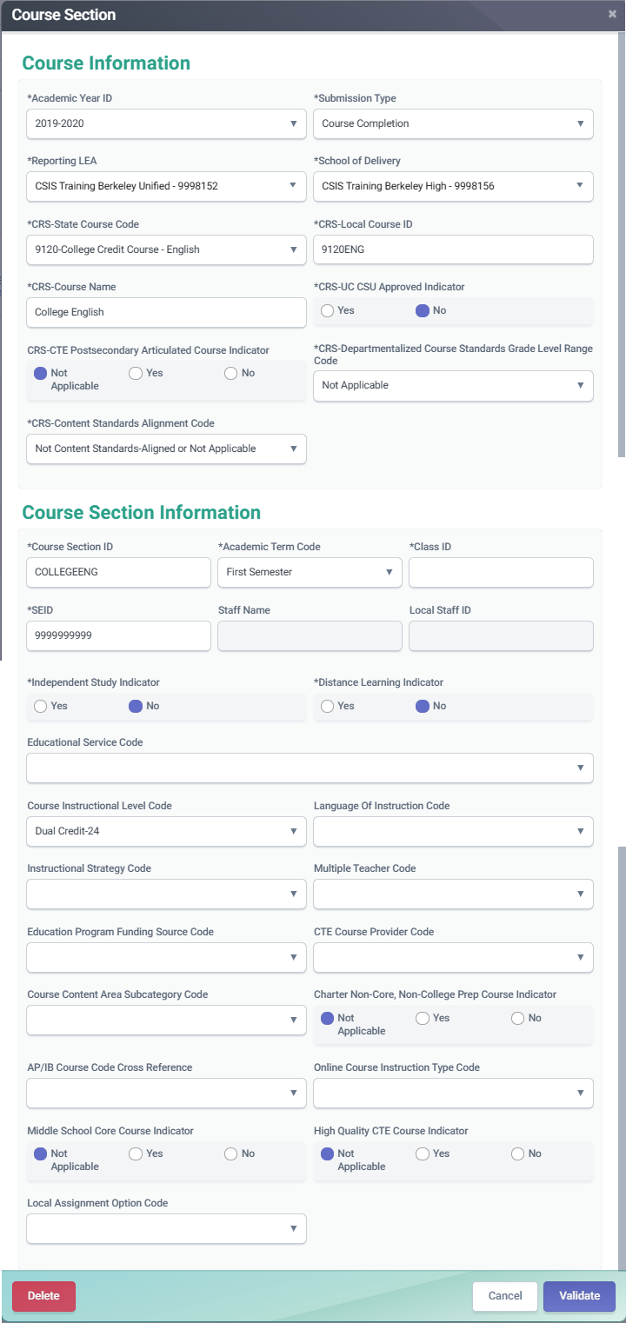
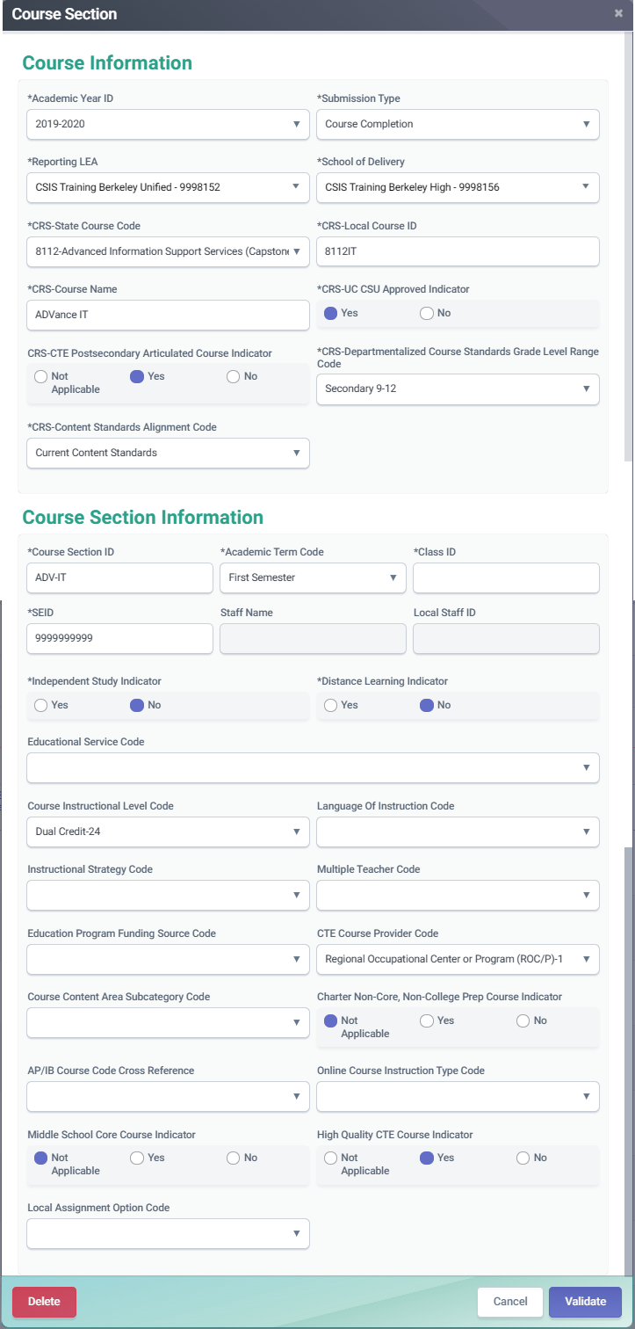
Course Completion (CRSC)
College courses should be reported using the designated state course codes. Those courses can be used as CCI indicators
OR
CTE courses for which a student earns college credit should have the Course Instructional Level code populated with 23 - College Credit or 24 - Dual credit
Notes:
Let’s dig a bit deeper into those college courses.
LEAs should report college courses that students complete with a C- or better, or passing, as it is one of the factors used in determining whether students are prepared for college/career on the CCI. LEAs should indicate in the course section record that courses are college level by using the appropriate CALPADS Course Code.
OR
For a college credit CTE courses, use the Course Section Instructional Level Code with either code 23 – College Credit Only, or code 24 – Dual Credit.
LEAs should only report a course as “Dual Enrollment” or “College Credit Only” if the student earns college credit upon completion. The student may earn high school credit in addition, but the student must also earn college credit.
If LEAs do not have SEIDs and staff information for college teachers, LEAs should submit “9999999999” as the SEIDs for the teachers in the Course Section record

Slide 24
Dashboard CCI Courses
State Course Code | State Course Code Name
9020 | College Credit Course – Visual Arts
9082 | College Credit Course – Dance
9096 | College Credit Course – Theatre
9120 | College Credit Course – English Language Arts
9154 | College Credit Course – World Languages
9200 | College Credit Course – History/Social Science
9227 | College Credit Course – Other
9273 | College Credit Course – Mathematics
9303 | College Credit Course – Music
9358 | College Credit Course – Science
9373 | Leadership/Military Science
7000–8999 | Any CTE course code indicated in Nonstandard Instructional Level as College Credit Only (23) or Dual Credit (24)
Notes:
Data submitted in the CRSC and SCSC files as part of the EOY 2 submission are used to identify whether students in the 4-year Adjusted Cohort Graduate Rate (ACGR) are prepared for college/career as measured by the College/Career Indicator (CCI) on the California School Dashboard.
The CCI looks at state course codes in the 9000 series or range, indicating college level courses, and courses in the 7000 – 8999 series or range, indicating CTE courses. The CCI looks in particular at CTE courses using Nonstandard Instructional Levels of 23 or 24, as this indicates a course is both CTE and college level or credit.

Slide 25
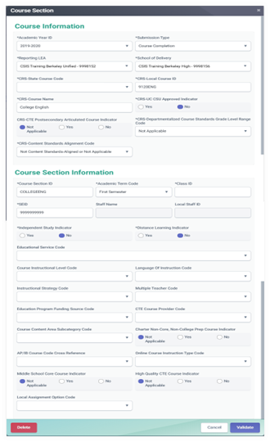
Course Completion AP/IB Reporting (CRSC)
Advanced Placement (AP) courses should have the appropriate state course code to align with a specific content area
International Baccalaureate (IB) courses must be reported with the appropriate state course code, unless they are Middle school IB courses.
Use the course instructional level field to indicate IB courses to Middle school as well as to the appropriate CTE course.
Notes:
Let’s talk about AP/IB courses.
LEAs should use designated state course code values for Advanced Placement (AP) or International Baccalaureate courses (IB).
AP courses should have the appropriate state course code selected and aligned with a specific content area.
IB courses must be reported with the appropriate state course code, unless they are Middle school IB courses. For Middle School IB courses, use the course instructional level field to indicate IB.

Slide 26
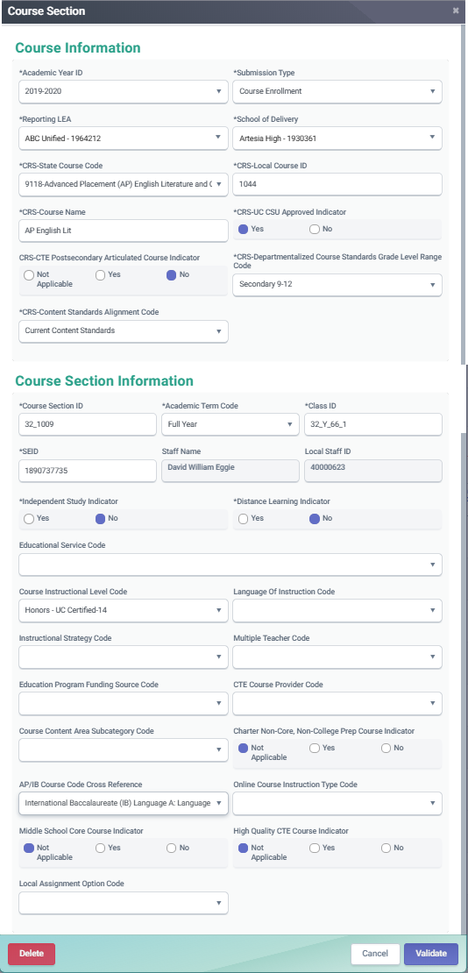
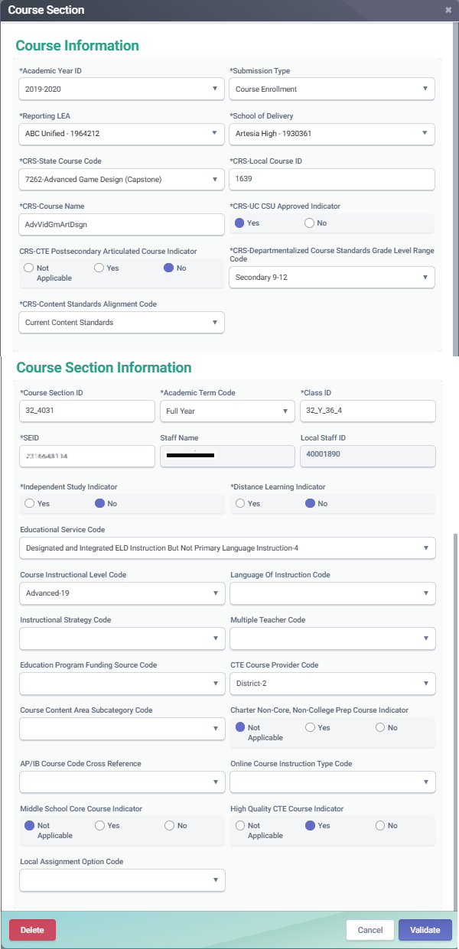
Course Completion CTE Reporting(CRSC)
CTE completers and non-completers must have SCSC records that correspond to the appropriate CTE course
CTE courses that are also AP or IB courses can have the AP/IB code cross reference populated so that the course maps to both content areas
Notes:
Let’s look now at CRSC records for courses which are both AP/IB and CTE.
Course completion data determines the LEAs’ CTE participant counts using the state course codes in the 7000 and 8000 series. All students completing CTE courses will be counted as “CTE participants” for federal Perkins reporting purposes. LEAs do not have to submit any additional data for CTE participant counts. CTE courses require the following fields to be populated:
CRS-State Course Code - State Course Codes in the 7000 and 8000 series are CTE courses
CRS-CTE Postsecondary Articulated Course Indicator - element is used to collect information on whether or not a CTE course has been articulated with a postsecondary institution.
CTE Course Section Provider Code - element indicates whether a given CTE course section is provided by:
A Regional Occupational Center (ROC) or Program.
The District.
High Quality CTE Course Indicator - indicates whether the course section is being taught by a CTE credentialed teacher.
Now let’s talk about the field highlighted in blue on the left hand side.
Previously, LEAs were forced to choose between populating either the CTE State Course Code or the AP or IB Course Code in CRSC records. In current times, LEAs are able to identify a course as both CTE and AP/IB. The AP/IB Course Code Cross Reference field is what allows this, as it allows the LEA to populate the State Course Code field with a CTE course code in the 7000 and 8000 series, while providing a cross-reference code to an AP or IB course. The AP/IB Cross Reference Code is a four-digit code which references AP/IB courses that an LEA has mapped to a CTE State Course Code because that course is part of a CTE pathway.
This concludes our discussion of the CRSC file, or the course section file tied to teachers via a SEID, and the reporting nuances in CRSC records. We will be moving into SCSC records on the next slide, so before we do are there any questions about CRSC records?

Slide 27
SCSC Attributes
Grades
Standard and nonstandard grades accepted
The final grade a student received after completing a specific Course Section
LEAs should not submit “progress report” grades, but only grades earned when credits are awarded.
Can be Alpha numeric or special character
Limited to three characters
UC/CSU Admission Requirement Code
Not a required field, but should be populated for courses students take that have been approved by UC/CSU institutions.
Course determination is made by the UC/CSU systems
Describes the requirement that a high school course has been determined to meet.
Applicable in departmentalized courses in grade 9-12
Credits
Student Credits Attempted and Student Credits Earned help LEAs view courses transferring students have completed in other LEAs.
Used to determine total credit requirements are met for graduation.
Carnegie Units
Granted to a student completing approximately 120 hours of class in one subject over the course of one year
SIS vendors will calculate the value
Required for the federal Migrant Student Information Exchange (MSIX)
Notes:
This slides contain key fields or attributes in SCSC records. There are 4 key attributes to be mindful of when populating SCSC records and reviewing associated EOY 2 aggregate reports in CALPADS. They are: Grades, Credits, Carnegie Units, and UC/CSU Admission Requirements Codes.
Grades:
Should be populate with the final grade a student received after completing a specific Course Section and are only required for departmentalized courses for students in grades 7-12. LEAs should not submit “progress report” grades, but only grades earned when credits are awarded.
Credits:
Required for grades 9-12. LEAs may submit course completion data either after the completion of an official grading period in which credits are awarded, or at the end of the year when students have completed all courses for the school year.
Carnegie Units:
In addition to Credits earned, student progress and achievement will be derived from SCSC records via the Carnegie unit. The Carnegie unit:
Is granted to a student completing approximately 120 hours of class in one subject over the course of one year. A total of 120 hours in one subject—meeting 4 or 5 times a week for 40 to 60 minutes, for 36 to 40 weeks each year—earns the student one “Carnegie unit” of high school credit.
Two semester courses equal one yearlong course. A yearlong course constitutes one Carnegie unit. Semester courses constitute one-half of a Carnegie unit. Most school districts award ten local units for each Carnegie unit and five local units for a semester course.
UC/CSU Admission Requirements Code:
Represents University of California or California State University College Admission Course Requirement that a high school course has been determined to meet. Possible code values describe subject areas:
A- History/Social Science
B - English Mathematics
C- Laboratory Science
D - Language other than English (i.e., foreign languages and American Sign Language)
F - Visual and Performing Arts
GA - History/Social Science
GB - Elective English
GC - Elective Mathematics
GD - Elective Laboratory Science
GE - Elective Foreign Language
GF - Elective Visual and Performing Arts Elective
GO - Other Elective
This is not a required field, but should be populated for courses that have been approved by UC/CSU institutuions. This field is only applicatble for departmentalized courses in grades 9-12.

Slide 28
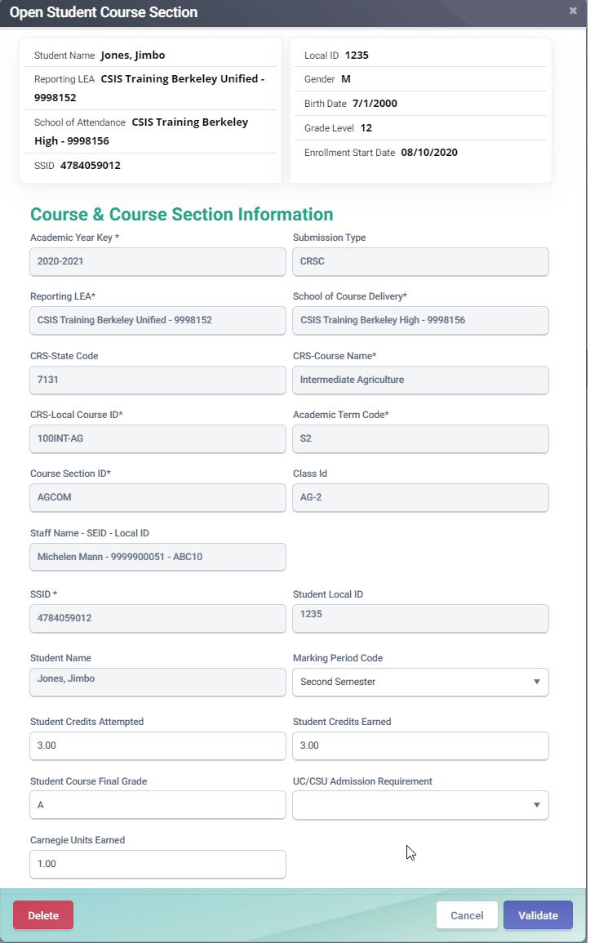
Course Completion (SCSC)
The UC/CSU Admission Requirement Code represents the category of University of California or California State University College Admission Course requirement that a high school course has been determined to meet.
A Carnegie Unit represents a student completing approximately 120 hours of class in one subject over the course of one year. Typically, 10 high school credits equal 1 Carnegie Unit, 5 high school credits are normally equal to 0.5 Carnegie units.
Notes:
Include all Student Course Section records for students enrolled at any time during the current academic year who completed a course and received a grade.
This following fields are required in the SCSC:
Academic Term Code - represents an Academic Term. An Academic Term is the period of time into which the education institution divides the academic year for the purpose of instruction.
Student Credits Attempted – are a count of the credits attempted for a specific Course Section in grades 9-12.
Student Credits Earned – are a count of the credits earned after a student completes a specific Course Section in grades 9-12.
Student Course Final Grade – is the final grade a student received after completing a specific Course Section for grades 9-12.
The following field is not required in the SCSC:
Marking Period Code - represents the period in which a course mark or grade is given to a student for a particular course.
The UC/CSU Admission Requirement Code is not required. This code represents the category of University of California or California State University College Admission Course requirement that a high school course has been determined to meet.
Finally, the Carnegie Units Earned is not required, but should be populated for student who have completed approximately 120 hours of class in one subject over the course of 1 year. The Carnegie unit equation for a typical LEA is explained on this slide.
And this concludes our discussion of the SCSC file. Are there any questions before we move into discussing the SCTE file?

Slide 29

Student Career Technical Education
LEAs must submit information on CTE Pathways that students have completed during the year.
Students who have completed a CTE Pathway during the Reporting Year, are included in the Student Career Technical Education (SCTE) file.
If a student has completed more than one Pathway during the Reporting Year, a record is reported for each completed Pathway.
CTE participants who are non-completers MUST NOT be included in the SCTE file, as the data collected for course sections and student course sections includes the information needed to identify them.
LEAs who do not have a CTE program should not report any CTE completion record even if CTE classes are offered as an elective.
Course and Student Course completion data.
Notes:
Now that we’ve concluded our discussion of SCSC records, lets turn to discuss the SCTE or Student Career Technical Education file.
LEAs must submit information on CTE Pathways that students have completed during the year.
Students who have completed a CTE Pathway during the Reporting Year, are included in the Student Career Technical Education (SCTE) file.
If a student has completed more than one Pathway during the Reporting Year, a record is included for each completed Pathway.
CTE participants who are non-completers are not included in the SCTE file, as the data collected for course sections and student course sections includes the information needed to identify them.

Slide 30
SCTE Data Collected
Along with key data from the CRSC and SCSC, the following data are collected
CTE Completer Info
CTE Pathway Code
CTE Completion Year
Identifies student who has completed a minimum of 300 hours in a state-approved CTE pathway.
Indicates the specific career pathway the student participated in and completed.
Indicates the academic year the student completed the capstone course for the pathway being reported
Notes:
The SCTE file provides us with CTE Completer information, identifying students who have completed a minimum of 300 hours in a state-approved CTE pathway. The SCTE file also indicates the pathways of completers as well as a completer’s completion year. The SCTE is a relatively small file but provides key data elements for the CA School Dashboard and feeds into the postsecondary status submission.

Slide 31
CTE Student Groups
CTE Participant:
The CDE counts as a participant, any student who has completed a CTE course (includes CTE Non-completers and Completers).
Non-Completer Participant: Is a student who:
has completed a CTE course who may or may not be participating in a pathway but does not meet the definition of a CTE completer below
Reported and determined through the CRSC and SCSC records
CTE Completer: A CTE completer is identified locally and is a student who has:
completed a sequence of CTE designated courses within a pathway and has successfully passed the capstone course in that sequence with a grade of C minus or better.
Reported through submission of the CRSC, SCSC and SCTE records
Notes:
CTE Participant: A CTE participant is a student who has completed the equivalent of a conventional 50-minute class taken five times per week for 180 school days, or approximately 150 hours of instruction in a state-recognized CTE pathway. The CDE counts as a participant, any student who has completed a CTE course.
A CTE Non-Completer Participant: A student who has completed a CTE course who may or may not be participating in a pathway but does not meet the definition of a CTE completer. CTE non-completer participation is reported and determined through the CRSC and SCSC records.
CTE Completer: A CTE completer is identified locally and is a student who has completed a sequence of CTE designated courses within a pathway, and Completing a capstone course, with a grade of C minus or better.
The CDE counts as a completer, students the LEA has identified as a completer by populating the Field 11.14 – CTE Pathway Completion Academic Year ID on the SCTE file with the current academic year. CALPADS validates whether students who are identified as CTE pathway completers on the SCTE file, have completed the capstone course in the pathway in the students SCSC records.

Slide 32
Mapping CTE information
Below is a summary of how different CTE student groups are reported in CALPADS.
CTE Participants
Non-completers
CRSC
Report CTE course
State course 7000-8999
SCSC
Submit SCSC associated to the CTE course
SCTE
Do not submit SCTE
CRSC
Report Capstone course appropriate to CTE Pathway
SCSC
Submit SCSC associated to the CTE course
SCTE
Submit SCTE
State course 7000-8999
CTE Pathway Completion Academic Year ID must be populated
CTE Pathway Completion Academic Year ID must be current year.
Report CTE Pathway Code
CTE Pathway Completers
Notes:
This slide provides a visual explanation for how CTE participants and pathway completers are reported in CALPADS. Let’s begin with the CTE non-completer participants.
The first step in reporting your CTE non-completer participants is to report Course Section Completion (CRSC) records for CTE courses, with state course codes in the 7000 – 8999 range. The CRSC record is tied to a staff member rather than a student.
You must go on to submit the Student Course Section Completion (SCSC) associated to the CTE course, or the CRSC record in the first step, in order to tie the student to the CTE course.
If the student is a non-completer participant, do not submit an SCTE record for the student. This is only done for CTE Pathway completer.
The first step in reporting your CTE Pathway completers, is to report the Capstone course appropriate to the CTE pathway in CRSC records, with the appropriate state course code. Capstone courses are the final courses necessary to complete a CTE pathway. The CRSC record is tied to a staff member Rather than a student.
You must go on to submit the SCSC associated with the Capstone course, or the CRSC record from the previous step, in order to tie your student to the CTE capstone course.
The final step is to submit the Student Career Technical Education or SCTE record for your completer student, reporting the CTE pathway code, and pathway completion academic year ID, which must be populated and must be the current AY.

Slide 33
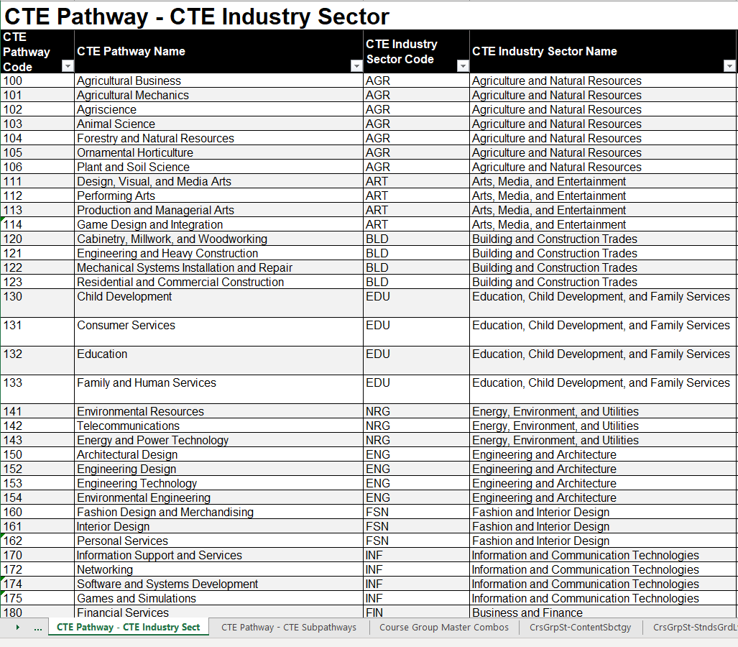
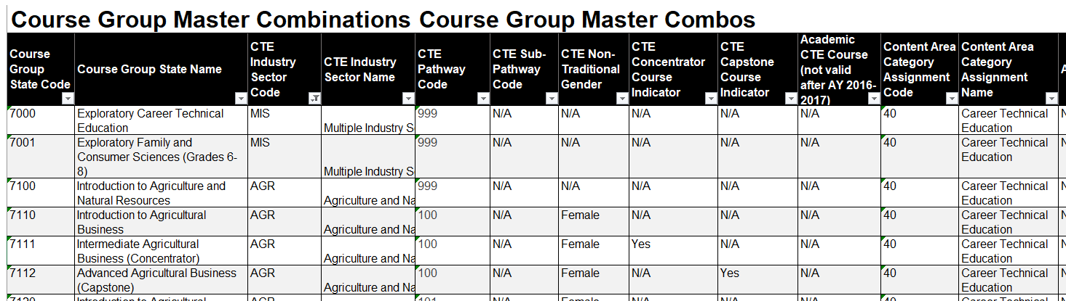
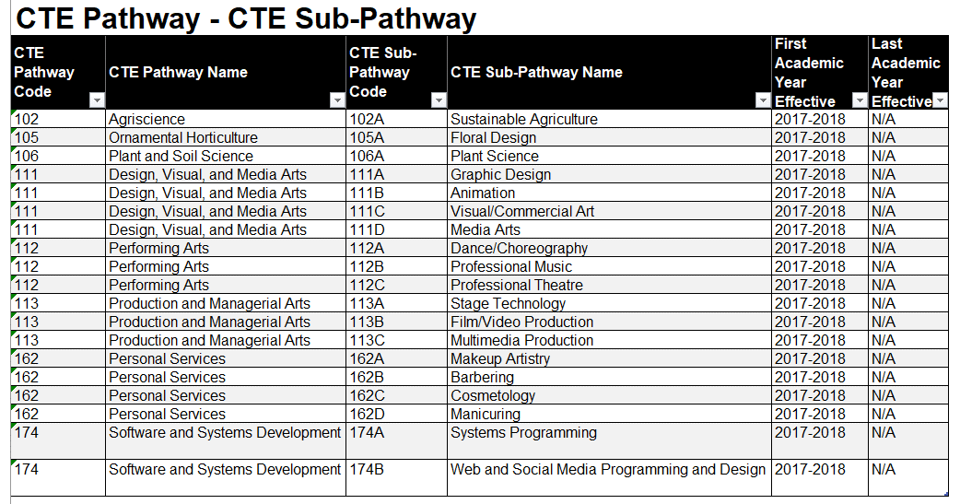
Valid Code Combo CTE Resources
Notes:
A common problem in EOY 2 reporting is that CTE state courses codes are mapped to the wrong pathway. CTE Pathways and CTE state course codes should be mapped so that they align with the content of the curriculum.
The Valid Code Combinations document is vital when mapping your CTE courses, and the Course Group Master Combos tab in particular when mapping CTE state course codes to pathways.
In the Couse Group Master Combinations tab, you are able to map Course Group State codes to CTE Pathway codes. This tab will also help you to determine whether a course is a concentrator course or a capstone course. In each CTE pathway there are state course codes for introduction, concentrator, and capstone courses.
On the screenshot on this slide for the Course Group Master Combos tab (upper right), the Agriculture CTE industry section includes CTE Pathway 100, which contain State Course Code 7110 – Introduction to Agricultural Business, State Course Code 7111 – Intermediate Agricultural Business (Concentrator), and 7112 – Advanced Agricultural Business (Capstone).
If you are reporting a student completing a pathway, they must complete a capstone this AY, and this must be reflected in SCSC records.
Yu are also able to identify CTE Pathways by Industry sector in the CTE Pathway – CTE Industry sector tab, and identify CTE sub-pathways by pathway, in the CTE Pathway – CTE Sub-pathway

Slide 34
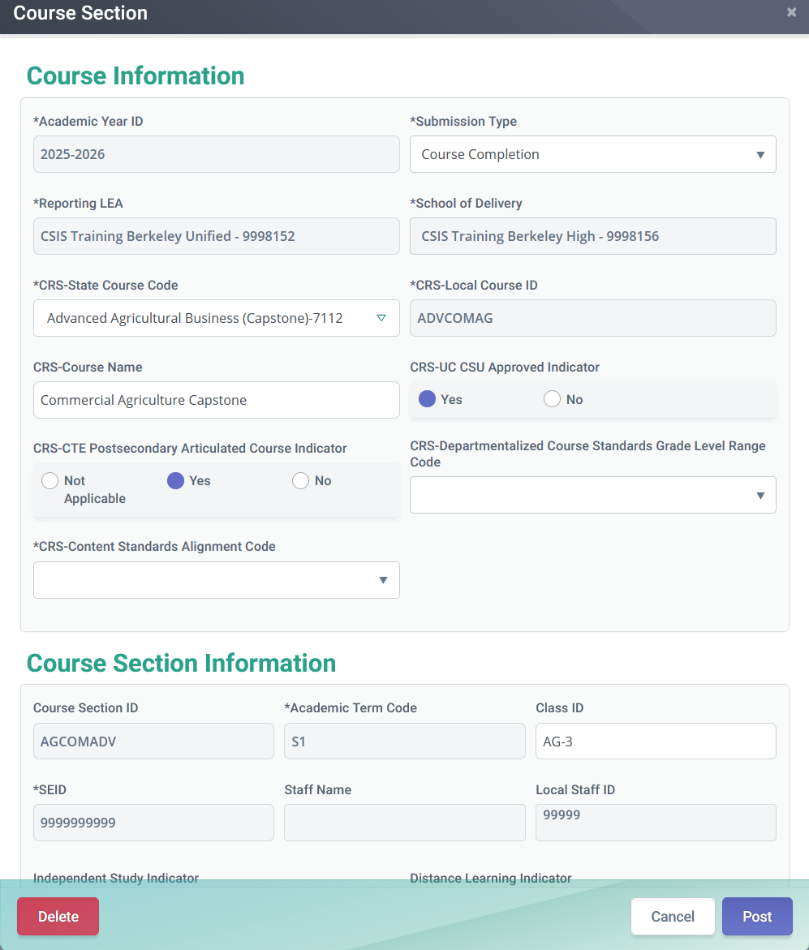
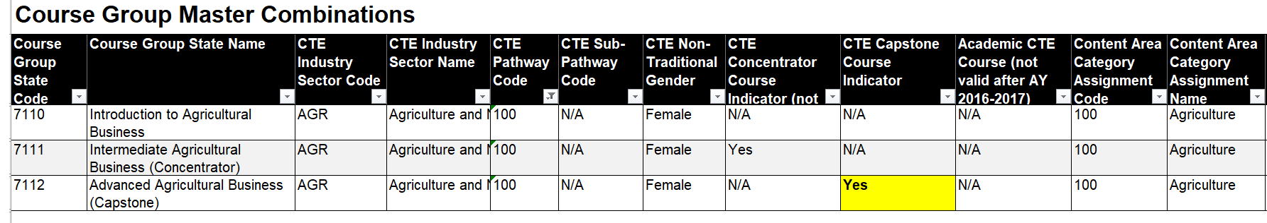
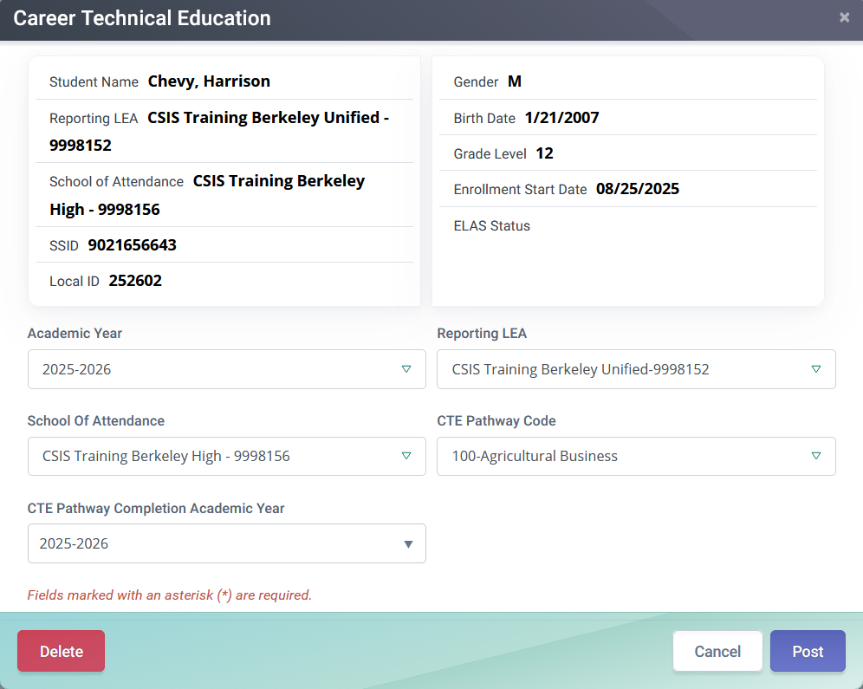
Reporting a CTE Completer
Below are the elements that comprise the CTE Completer data of a student.
Must have a SCSC record associated to a CTE Capstone course.
A SCTE record must be submitted reflecting the CTE pathway code.
Completion Academic Year must be 2025-2026.
Notes:
This slide shows where in SCSC and SCTE records you populate or input CTE completer data that we used the valid code combinations document to map.
In the SCSC record for your CTE completer student, you want to ensure that you use a CRS State Course Code that represents the capstone course for the CTE pathway. In the example on screen, this is Course Group State Code 7112 – Advanced Agricultural Business (Capstone). This is designated as a capstone course in the Valid Code Combinations document, both by the inclusion of (Capstone) in the course group state name, and by the “Yes” in the “CTE Capstone Course Indicator” field.
Once the SCSC record has been posted, you will go on to submit the SCTE record. In the SCTE record, you will want to ensure that you populate the correct CTE pathway code, also found in the Valid Code Combinations document, and populated with “100 – Agricultural Business” in the example on screen. You then want to populated the CTE Pathway Completion Year, which must be AY2025-2026 for this AY’s CTE completers.

Slide 35
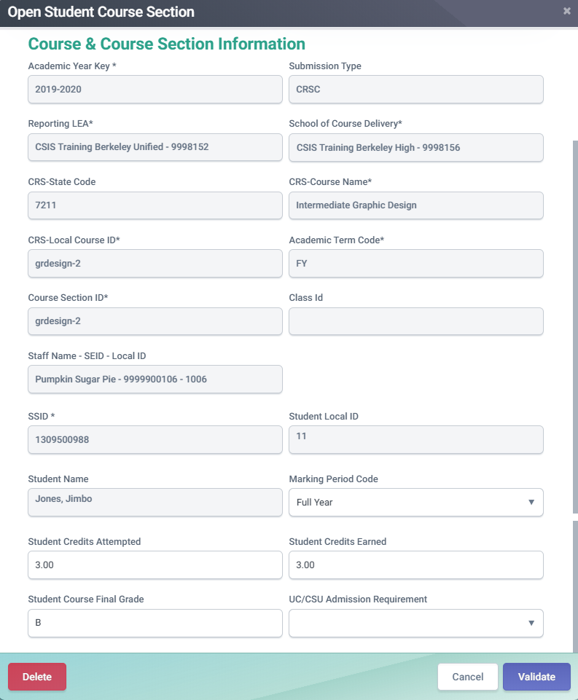
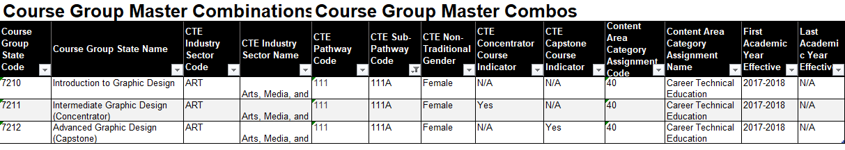
How CTE Non-Completers are determined
Below are the elements that CALPADS will use to determine a student as a CTE Non-Completer participant.
SCSC Record
For CTE Pathway Participants: Must have a SCSC record associated to a CTE course that is identified as Intro or Concentrator course
For Non-CTE Pathway Participants: Must have a SCSC record associated to any CTE course.
Notes:
This slide shows the fields or data elements that CALPADS uses to determine CTE non-completer participants.
SCSC records for non-completer participants must use a CRS State Course Code that identifies the course as a CTE Introduction or Concentrator course. This must be a code that designates a non-capstone CTE course.
This concludes our discussion of CTE reporting.

Slide 36

Work-Based Learning
LEAs must submit work-based learning data that will provide additional opportunities for students (grades 9-12) to demonstrate their preparedness for college/career through the College/Career Indicator (CCI) on the California School Dashboard.
There are twelve work-based learning programs/activities that LEAs should track and report to CALPADS on the WBLR file.
The WBLR uses the Replacement processing method by Academic Year and School of Attendance and is used for batch processing.
Notes:
Let’s jump into our discussion of the Work-Based Learning or WBLR file type. LEAs must submit work-based learning records in EOY 2 for students in grades 9-12, to measure their preparedness for college or career. This data feeds directly into the College/Career Indicator (CCI) on the California School Dashboard.
There are twelve work-based learning programs/activities that LEAs should track and report to CALPADS on the WBLR file. These are very specific and defined in the CALPADS Code Sets document, and we will cover the twelve program codes in a couple of slides.
The WBLR uses the Replacement processing method using the Operational Keys of Academic Year and School of Attendance and is used for batch processing.

Slide 37


WBLR Data Collected
LEAs are required to submit work-based learning completion information for:
    All students that complete an internship
    Include all Work-Based Learning completion for students enrolled at any time during the Reporting Year
    Data will come from SIS but gathered by a team of CTE, SPED and CALPADS coordinators
LEA Admins will need to assign the WBLR Edit, View, and Extract roles to account and other user accounts. SELPAs will need to request the state to add the WBLR Extract role to their account.
Reference Available: CALPADS Flash 184 & 229 WBRL Data Population CALPADS User Manual
37
Notes:
LEAs must submit Work Based Learning or WBLR records to CALPADS for all students in grades 9-12 who participate in an internship or other work-based learning program while enrolled at the LEA.
This includes completion of any work-based learning for students enrolled at the LEA at any time during the reporting year. Work-based learning data is found in the local SIS and gathered by a team of CTE, SPED, and CALPADS coordinators. Though you will commonly find work-based learning data within CTE and Special Education, it is not exclusive to these two areas, and students can be in work-based learning programs with any measure of curriculum throughout your schools. Because of this, it is important to have a process in place for identifying and reporting work-based learning programs.
LEA Admins will need to assign the WBLR Edit, View, and Extract roles to their account and other user accounts working with the WBLR file. SELPAs will need to request the state to add the WBLR Extract role to their account.
References:
CALPADS Flash 184: https://www.cde.ca.gov/ds/sp/cl/calpadsupdflash184.asp
CALPADS Flash 229: https://www.cde.ca.gov/ds/sp/cl/calpadsupdflash229.asp
CSIS WBLR Data Population: https://www.youtube.com/playlist?list=PLsnFpLOXpp4KDvoW_Hg8BenKP53bv3MGl
CALPADS User Manual: https://documentation.calpads.org/OnlineMaintenance/StudentDataMaintenance/StudentDetailsWBLR/
Work-Based Learning Measures for the CCI:
https://www.cde.ca.gov/ta/ac/cm/workbasedcci.asp#newmeasures
References:
CSIS WBLR Data Population: https://www.youtube.com/playlist?list=PLsnFpLOXpp4KDvoW_Hg8BenKP53bv3MGl
CALPADS User Manual: https://documentation.calpads.org/OnlineMaintenance/StudentDataMaintenance/StudentDetailsWBLR/

Slide 38
Work-Based Learning Type Code
Coded Value | Name
10 | Internship
15 | Student-led Enterprise
20 | Simulated Work-Based Learning
25 | Registered Pre-Apprenticeship Program
35 | Job Corps
40 | Workforce Innovation and Opportunity Act (WIOA)
45 | YouthBuild
50 | California Conservation Corps
60 | Transition Work-Based Experience
65 | Transition Classroom-Based Work Exploration
The Work-Based Learning Type Code represents the work-based learning that the student completed during the academic year.
Students may have multiple work-based learning codes
Include summer work-based learning
Exclude summer internships that occur after the student has graduated
EOY 2 Reporting and Certification v1.0 May 06, 2025
38
Notes:
WBLR field 21.09, Work-Based Learning Type Code is a coded value representing the work-based learning that a student has completed during the academic year, in any grades 9 - 12. The codes are defined in the CALPADS Code Sets, and represent: Internships, student-led enterprise, virtual or simulated work-based learning, registered and non-registered pre-apprenticeship programs, job corps, the Workforce Innovation and Opportunity Act, YouthBuild, CA Conservation Corps, Transitional work-based experience, and transition classroom-based work exploration.
LEAs should report the work-based learning in the year it was completed. A single student may have more than one work-based learning activity reported for the academic year. Report summer work-based learning for grades 9-11, however do not include summer internships that occur after the student has graduated. The Work-Based learning Code will dictate that other fields be populated.
Work-based learning Type Code 30 – Non-Registered Pre-Apprenticeship Program is planned to be retired in AY2024-2025.

Slide 39
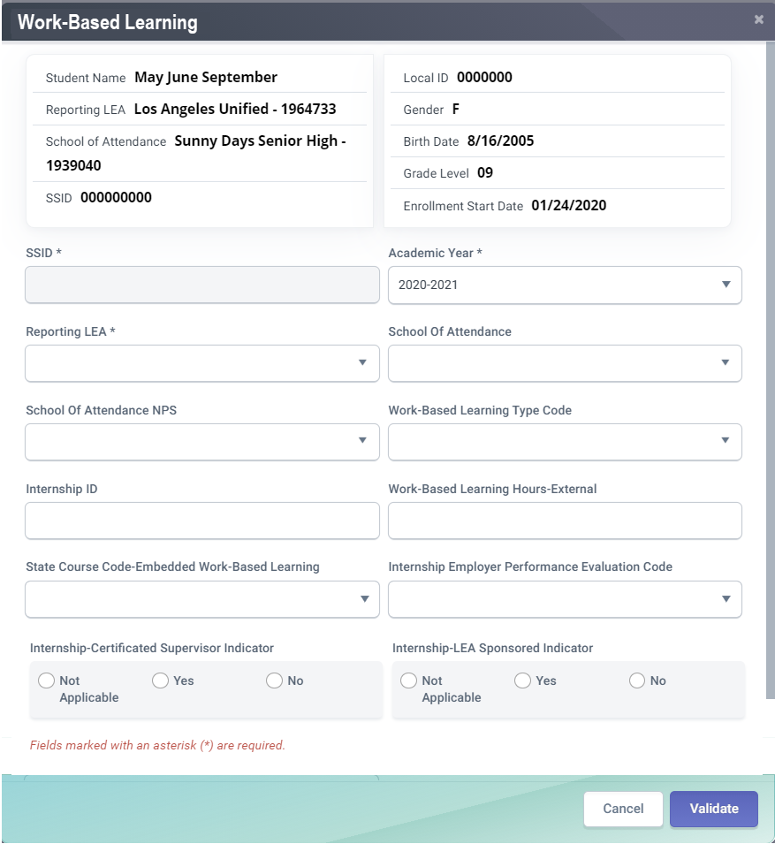
WBLR Data Fields
CFS# | Field Name
21.09 | Work-Based Learning Type Code
21.10 | Internship ID
21.11 | Work-based Learning Hours - External
21.12 | State Course Code -Embedded Work-based Learning
21.13 | Internship -Employer Performance Evaluation Code
21.14 | Internship -LEA Sponsored Indicator
21.15 | Internship –Certificated Supervisor Indicator
21.09
21.10
21.11
21.12
21.13
21.14
21.15
EOY 2 Reporting and Certification v1.0 May 06, 2025
39
39
Notes:
The WBLR file features student demographic and enrollment data for identification and verification, but there are seven fields of data specific to work-based learning.
Work-Based Learning Type Code - A coded value representing the work-based learning that the student completed during the academic year, in any grades 9 - 12.
Internship ID - A unique identifier for an internship work-based learning activity.
Work-based Learning Hours – External - The count of hours that the student spent outside of school in a work-based learning activity in the academic year being reported. This field is only populated for WBLR types 10 – Internship, 15 – Student Led Enterprise, and 20 – Virtual or simulated work-based learning. While the hours are outside of classroom, the work-based learning activity is tied to the Internship, Student-Led Enterprise, or Simulated Work-Based Learning.
State Course Code - Embedded Work-based Learning - The State Course Code that the student completed in which the Student-Led Enterprise or Simulated Work-Based Learning was embedded. This will be required for Work-Based Learning Type 10 – Internship in 2024-2025.
Internship - Employer Performance Evaluation Code - A coded value representing the student’s performance in the internship as evaluated by their employment supervisor.
Internship - Certificated Supervisor Indicator - An indication of whether the internship was part of a program supervised by a certificated staff member of the school, district, or county. A “Y” would indicate that the internship was part of a program supervised by a certificated staff member of the school, district, or county. An “N” would indicate that it was not.
Internship - LEA Sponsored Indicator - An indication of whether the school, district, or county played a direct role in securing the internship for the student. A “Y” would indicate that the school, district, or county played a direct role in securing the internship. An “N” would indicate it did not.

Slide 40
*NEW* Employer Performance Evaluation Code in AY2023-2024
Code | Name | Definition
5 | Not Provided by Employer | The student did not receive a rating because the employer: (1) failed to provide an evaluation or (2) did not evaluate the student’s performance on the internship
*Upcoming* Work-Based Learning Type Code Retiring in AY2024-2025
Code | Name | Definition
30 | Non-Registered Pre-Apprenticeship | The student successfully completed, during the academic year, a non-registered pre-apprenticeship program, is recognized by business but is not registered at the state or national level. These pre-apprenticeships provide employer-designed coursework and job-learning activities that prepare students for an existing apprenticeship program.
CALPADS Update Flash #265
Notes:
This and further information on WBLR changes contained in Flash #265 here: https://www.cde.ca.gov/ds/sp/cl/calpadsupdflash265.asp
Employer Performance Evaluation Code
LEAs populate Field 21.13 − Internship-Employer Performance Evaluation Code on the WBLR file with codes from the "Internship Employer Performance Evaluation" code set. Previously, there were four codes in this code set, including: 1- Does Not Meet Expectations, 2 – Partially Meets Expectations, 3 – Meets Expectations, and 4 – Above Expectations. A fifth code, "Not Provided by Employer," has been added in 2023-24, and is defined as “The student did not receive a rating because the employer: (1) failed to provide an evaluation, or (2) did not evaluation the student’s performance on the internship.”
Work-Based Learning Type Code
The State Board of Education (SBE) removed the Work-Based Learning Type Code 30 - Non-registered Pre-Apprenticeships from use in the College/Career Indicator at their September 2023 meeting. Therefore, the Work-Based Learning Type Code 30 - Non-Registered Pre-Apprenticeship Program is being retired beginning in 2024−25. LEAs may continue to submit this Work-Based Learning Type in 2023−24, but it will not be used. Beginning in 2024−25, if this code is included in the WBLR file, the file will fail upon input.

Slide 41

Inclusion of One-Year Graduates and Completers Report
Previous EOY 3 plus One-Year Graduates & Completers for all students (August 16 – August 15) will now be included in the certified EOY 2 reports.
5th/6th Year Seniors & Summer Grads: These reports are specifically designed to capture students who graduate after the regular school year, including those graduating in the summer up to August 15, ensuring they are properly credited.

Slide 42
Checklist
All reportable courses are mapped to the State Course codes
All required fields for courses are populated and up to date, including:
  Content Sub-Category
  Standards Grade Range
  Content Standards Alignment
  Middle School Core (Yes/No)
  AP/IB Course Code Cross Reference - if needed
SIS vendor has translated credits earned into Carnegie Units
The following have been identified and reported in the SIS:
  CTE Completers
  Students completing Leadership/Military Science courses
  Students who have received Seal of Biliteracy and/or Golden State Seal
  Students completing College Credit courses
  Work-Based Learning (WBL) Types for all grade 9-12 students who participated entered in SIS
In addition to WBL Type, all WBL Internships (Type 10) also have the following populated:
  Internship ID
  Work based Learning Hours - External
  Employer Performance Evaluation Codes
  LEA Sponsored Indicator
  Certificated Supervisor Indicator
In addition to WBL Type, all WBL Student-Led Enterprise (Type 15) and Virtual/Simulated Work-Based Learning (Type 20) also have the following populated:
  Work-based Learning Hours - External
  State Course Code - Embedded Work-based Learning
Ensure that all graduates and completers up until 8/15/2026 are accounted for.
Notes:
We’ve now completed our discussion of the file types involved in EOY 2. This slide contains the EOY 2 checklist, which shows the priority of the data that will need to be populated and reported prior to looking at certification errors and reviewing reports.
You will want to be familiar with reportable state course codes, which can be found in the CALPADS Code Sets and Valid Code Combinations documents. These will be populated CRSC, SCSC, and SCTE records and must be mapped.
The content subcategory code is located in Course Section files and provides information about the specific mode or subcategory of the Course Content Area that is being taught. So, for example, if the Course Content Area is Foreign Language, the Content Sub-Category would be a specific language like Spanish, French, or Latin. If the Course Content Area is Visual Arts, the content subcategory would be the specific visual art, whether drawing, ceramics, painting, etc.
The standards grade level range is an indication of whether the course is taught to elementary grades K-4, Middle grades 5-8, Secondary grades 9-12, or not application.
The content standards alignment code is a coded value representing the currency or recency of the standards that were used to develop the content of a course.
The middle school core setting is an indication of whether or not a course in grades five through eight is being taught as part of a middle school core setting. For example, a two-period block of math and science in grades five through eight could be considered a middle school core setting.
The AP/IB Course Code Cross reference is the four-digit cross reference to the actual AP or IB State Course Code for AP or IB courses that a local educational agency has mapped to a Career Technical Education (CTE) State Course Code (7000-8999) because that course is part of a CTE pathway. This is only necessary if applicable to a course or courses at your LEA.
After you have ensured that all required fields for courses are populated and up to date, you will want to move on to step 3 and ensure that your Student Information System vendor has translated credits earned into Carnegie Units. This may not be as relevant as when Carnegie units were first introduced.
You will then want to ensure that all of your College Career Indicator or CCI data is reported in the local SIS. This includes CTE completer data, student Leadership or Military Science course completions, students who have received the state Seal of Biliteracy or Golden State Seal, students who have completed college credit courses, and work-base learning types for grades 9-12 who participated in wblr programs. All of this data informs the CCI on CA School Dashboard.
In the WBLR file, Type 10 programs, or internship programs, must have the following populated: Internship ID, Work based Learning Hours – External, Employer Performance Evaluation Codes, LEA Sponsored Indicator, and Certificated Supervisor indicator.
WBLR Type 15 or Student Led Enterprise and WBLR Type 20 or virtual/simulated work-based learning programs reported in the WBLR file must have work-based learning hours – external, and the state course code – embedded work-based learning fields populated.

Slide 43

Certification
Process overview and error resolution
Notes:
Let’s move on to discuss certification by providing an overview of the certification process and guidance towards error resolution generally.

Slide 44
Certification Workflow
Error Correction
Resolve Cert errors before reviewing reports.
Refer to the downloadable CALPADS Error List on suggest resolutions
Review Reports
LEA Approval
LEA Submission Process
CERT Error Correction
Report Review
Generate reports and disseminate to appropriate staff responsible for the data.
Utilize report mapping guide to check for data inclusion and column count source
Submit files
Be aware of replacement type processing
Be aware of order of submission
You may now submit SDEM, CRSC files and available SCSC records
Approval
Generate reports and disseminate to appropriate staff responsible for the data.
Review all aggregate reports to activate checkbox
Check box to activate approval button
Notes:
EOY 2 has a streamlined certification process involving 4 steps.
LEA submission process, where you will submit the different file types involved in EOY 2. During this step, you should:
Be aware of replacement type processing and
Be aware of the recommended order of file submission.
If you are proactive, you may begin submitting SDEM, CRSC files and available SCSC records now.
After the submission is complete the LEA will resolve certification errors including anomalies. During this step, you should:
Refer to the downloadable CALPADS Error List to determine suggest error resolutions
Once all certification errors are resolved the LEA will disseminate reports for review. During this step, you will:
Generate reports and disseminate to appropriate staff responsible for the data.
Utilize report mapping guide to check for data inclusion and column count source
After the reports have been reviewed the LEA can LEA approve and certify. During this step, you will:
Generate reports and disseminate to appropriate staff responsible for the data.
Review all aggregate reports to activate checkbox
Check box to activate approval button
Resource:
Certification Process: https://documentation.calpads.org/CertificationStatus/CertificationStatusLEAApproval/
Video: https://www.youtube.com/playlist?list=PLsnFpLOXpp4Itub_qeFnInTgT0zJulxUb

Slide 45
EOY 2 Errors
Error # | Error Name | Severity | Error Type
CERT001 | Enrollment Data Missing for Expected Open School | F | CVR
CERT102 | No CTE Completer Data | W | CVR
SASS0121E2 | Missing Staff Demographic Record | F | CDD
SENR0661E2 | Invalid Student Race Missing Indicator and Student Race Code Combination | F | CDD
SENR0716E2 | Invalid Student Ethnicity Missing Indicator and Student Hispanic Ethnicity Indicator | F | CDD
SENR0717E2 | Missing overlapping SINF record | F | CDD
CRSC0545E2 | Invalid SEID in Course Section record | W | N/A
CRSC0548E2 | Submitted SEID missing Staff Assignment (SASS) Record | W | DD
CRSC0686E2 | No Enrollment for Course Section (CRSC) | W | DD
SCTE0698E2 | Missing or invalid SCSC record for CTE Completer | F | CVR
SENR0317E2 | Student Enrollment Record in Previous AY Not Exited | F | CDD
SENR0687E2 | No Student Course Section Data for a Secondarily or Short-Term Enrolled Student | W | CDD
SENR0713E2 | No Student Course Section Data for a Primarily Enrolled Student (SCSC) | W | DD

Slide 46
More EOY 2 Errors
Error # | Error Name | Severity | Error Type
SCSC0139E2 | Missing Course Section Record | F | CDD
SCSC0140E2 | Missing Student Credits Attempted | F | CDD
SCSC0141E2 | Missing Student Credits Earned | F | CDD
SCSC0512E2 | Missing Carnegie Units Earned | F | CDD
SCSC0681E2 | Student Course Section for SSID Not Enrolled during Report Period | F | CDD
WBLR0576E2 | SWDS record must exist for this Work-Based Learning Type | F | CDD
WBLR0649E2 | Missing State Course Code - Embedded Work-Based Learning for Internships | F | CDD
SCSC0139E2 | Missing Course Section Record | F | CDD
SCSC0140E2 | Missing Student Credits Attempted | F | CDD
SCSC0141E2 | Missing Student Credits Earned | F | CDD
SCSC0512E2 | Missing Carnegie Units Earned | F | CDD
SCSC0681E2 | Student Course Section for SSID Not Enrolled during Report Period | F | CDD
CERT055 | High school with No Enrollment in Career Technical Education | W | CVR
CERT169 | No WBLR Data Submitted for a School | W | CVR
CERT175 | Significant Change in Percent of Graduates | W | CVR

Slide 47
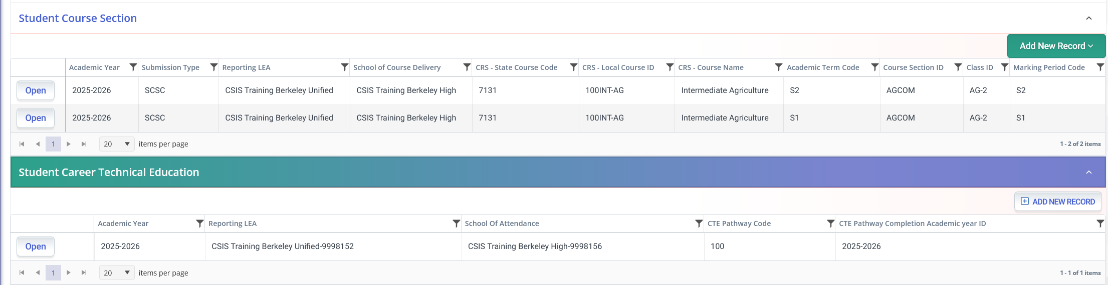
SCTE0698E2
No SCSC record submitted to reflect a CTE Capstone Course code for indicated pathway
Trigger reasons
SCSC file not uploaded
SCSC file uploaded but record rejected.
Posted a SCTE record this year but completed Pathway last year.
Inadvertently posted a SCTE record
Notes:
The SCTE06982E2 error triggers when a student with a SCTE Completer record has not completed at least one capstone course associated with the CTE pathway in the SCTE record, as indicated in the CALPADS Valid Combinations - Course Group Master Combos.
[too confusing:] Things to check in the submission: Ensure you have submitted at least one SCSC record with a Course Section ID for the student that is mapped to a CRS-State Course Code in a CRSC record that can then be mapped to the CTE Pathway specified for the student in the SCTE file and the SCSC record must have a Capstone Course Indicator = Yes.
Suggested Resolution: If the student did not complete a course for the academic year in the CTE Pathway specified in the SCTE file, then remove the student's record from the SCTE file. If the student is a completer in that CTE Pathway, ensure you have submitted at least one SCSC record with a Course Section ID for the student that is mapped to a CRS-State Course Code in a CRSC record that can then be mapped to the same CTE Pathway specified for the student in the SCTE file. Verify that the course completed maps to a state course code whose Capstone Course Indicator (in Course Group Master Combos) = Yes.

Slide 48

EOY 2 Reports
Review reports

Slide 49
EOY 2 Reports
Report 3.9
Report 3.10
Report 3.11
Course Sections Completed – Count by Content Area for Departmentalized Courses
Course Sections Completed – Count and Details for Departmentalized Courses
Course Sections Completed – Student List for Departmentalized Courses
Legend
Report 3.14
Report 3.15
Report 3.16
Educational Options Course Completion – Student Count
  Career Technical Education Noncompleter Participants - Count
  Career Technical Education Noncompleter Participants– Student List
Aggregate Report
Supporting Report
Report 3.19
Report 3.20
  Career Technical Education Completers – Count by Pathway
  Career Technical Education Completers– Student List
Report 18.1
Report 18.2
  Work-Based Learning -Count
  Work-Based Learning – Student List
Report 1.22
Report 1.23
Graduates and Completers Count
Graduates and Completers Student List
Notes:
For End of Year 1 there are 5 aggregate reports, shown in green on this slide. They are:
Report 3. 9 – Course Sections Completed – Count by Content Area for Departmentalized Courses
Report 3.14 – Career Technical Education Non-Completer Participants – Count
Report 3.16 – Education Options Course Completion – Student Count
Report 3.19 – Career technical education completers – count by pathway
Report 18.1 – Work Based Learning - Count
There are also multiple supporting reports which provide more specific counts or detailed lists of students who were counted in the aggregate reports.
The arrows on the slide show how the reports link to other reports, with arrows going from each aggregate report to their associated supporting reports.
So, e.g., Report 3.15 – Career technical education – non-completer participants – student list, is a supporting report which helps you to interpret report 3.14 – Career Technical Education – Non-Completer Participants – Count and reconcile it with your SIS. 3.15 includes the list of students counted in report 3.14.
Please review the EOY 2 Data Mapping Guides in the user manual -- https://documentation.calpads.org/Reports/SnapshotODSReports/#eoy-1-report-mapping-guides. This resource will assist with data elements that are used in the counts for the aggregate reports.

Slide 50
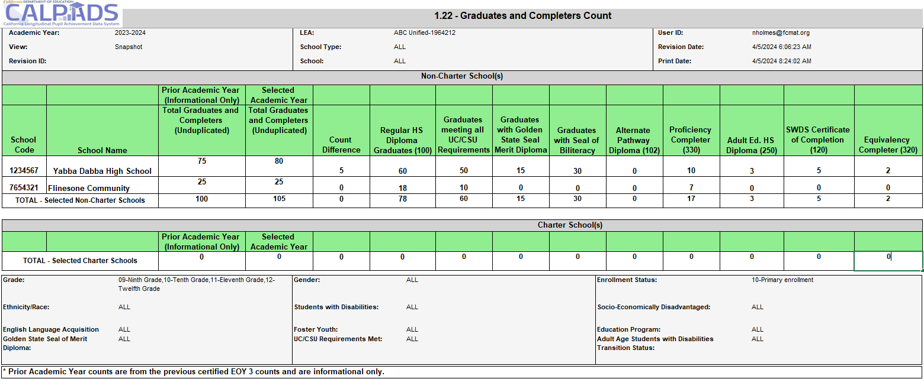
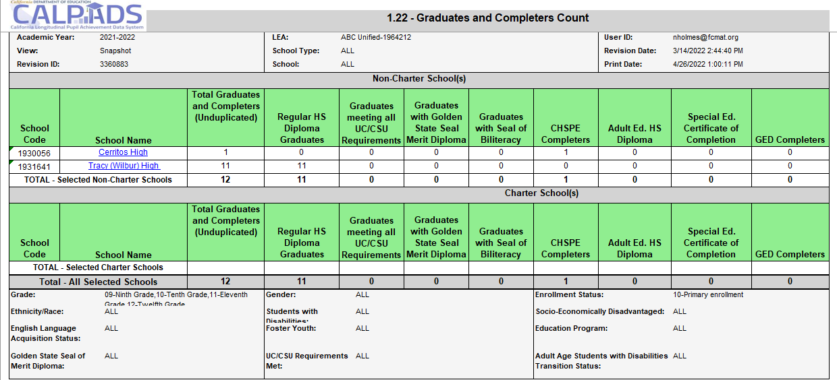
Report 1.22 – Graduates and Completers
Notes:
Three new columns added to the LEA Certification and County/Authorized LEA (C/A) report 1.22 Graduates and Completers - Count
Count of Graduates Meeting UC/CSU Requirements
Count of Graduates with Golden State Seal Merit Diploma
Count of Graduates with Seal of Biliteracy
These counts were previously available in the now retired 1.9 Completers and Dropouts Counts report.

Slide 51
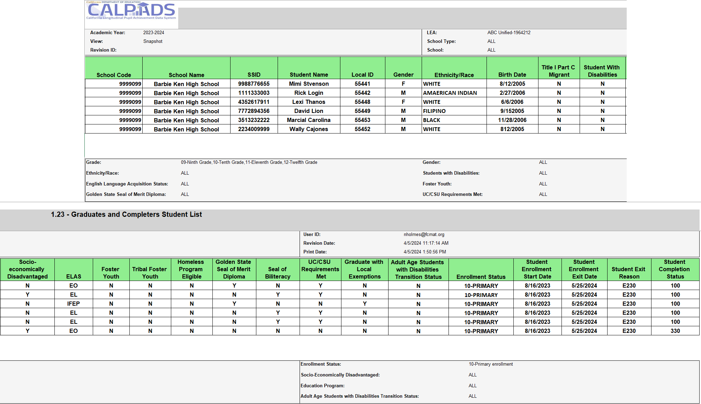
Report 1.23 – Graduates and Completers Student List

Slide 52
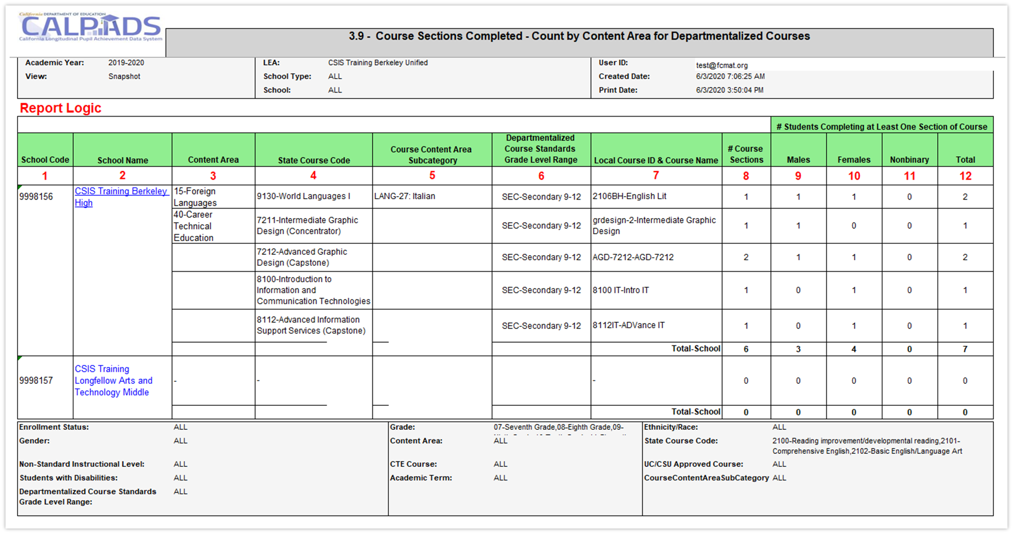
Report 3.9 Course Sections Completed
Count by Content Area for Departmentalized Courses
Notes:
Report 3.9 reports the number of departmentalized course section completion records for each Course within a Content Area. The content area is determined by the state course code. For each course, it includes the number of students who completed at least one course section of the course.
Note: a student in multiple course sections related to one local course ID is counted only once. A student with a same course section and term with multiple marking periods is counted only once.

Slide 53
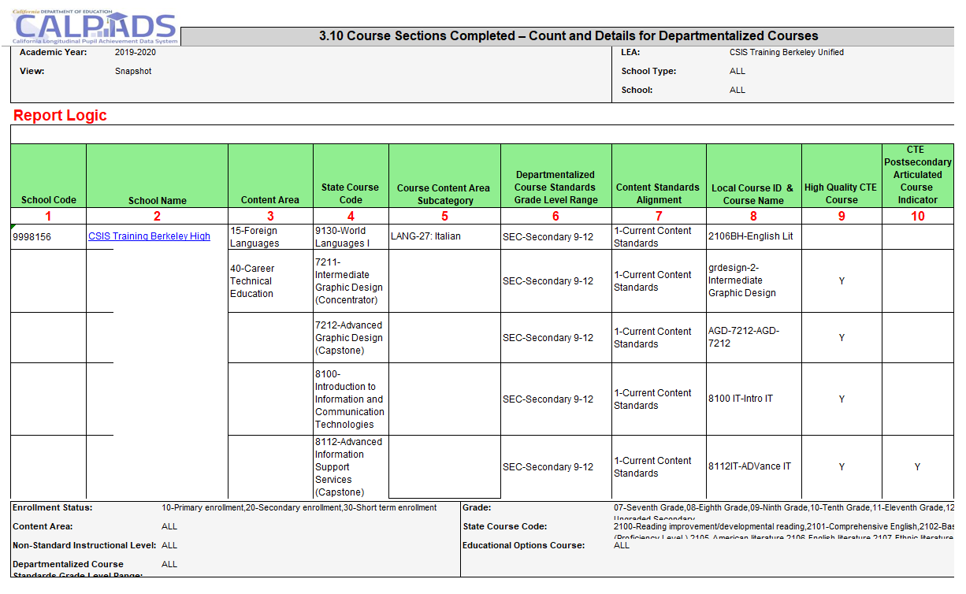
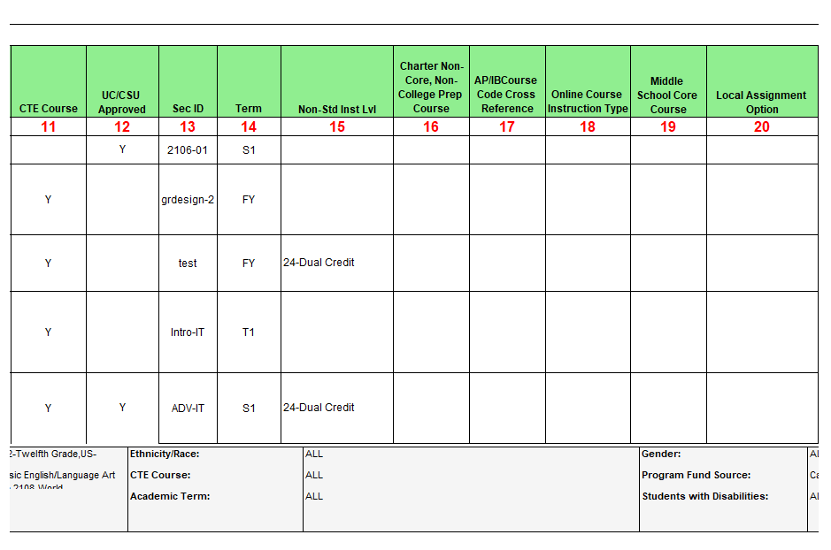
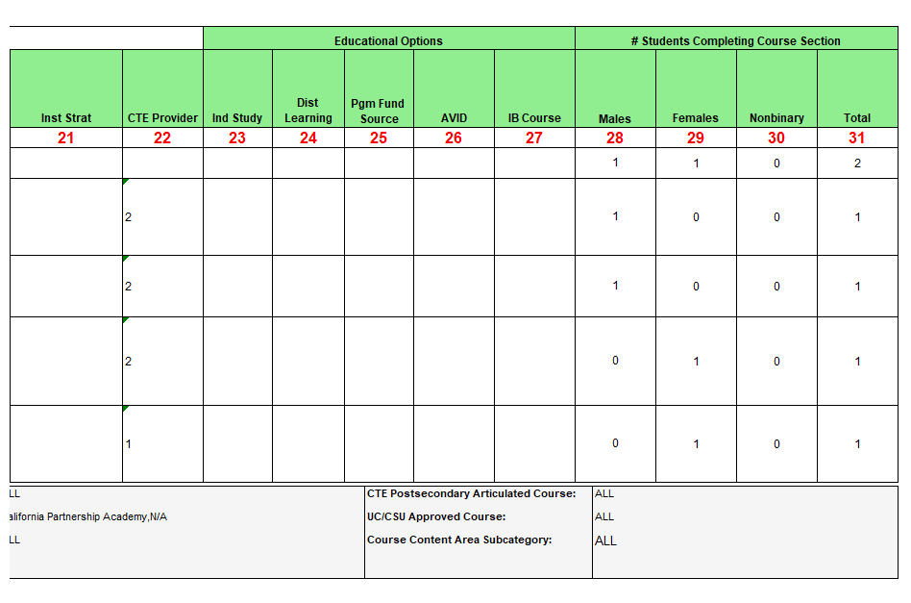
Report 3.10 Course Sections Completed
Count and Details for Departmentalized Courses
Notes:
Report 3.10 reports the details of completed local course sections by State Course Code within Content Area as well as the number of students who completed each course section. This is a support report to report 3.9.
This supplemental report can assist with finding your college credit and leadership miliary science courses, as well as your CTE courses. To find both sets of courses (college/leadership or military science & CTE) the report should be request twice with different filters.
To find college credit courses and Leadership/Military Science in the 9x series select the State Course codes of 9020, 9082, 9096, 9120, 9154, 9200, 9227, 9273, 9303, 9358, 9373
To find the CTE courses with the Non Standard Instructional codes of 23 and 24 select the CTE Course = Y and Non Standard Instructional Level to 23 and 24

Slide 54
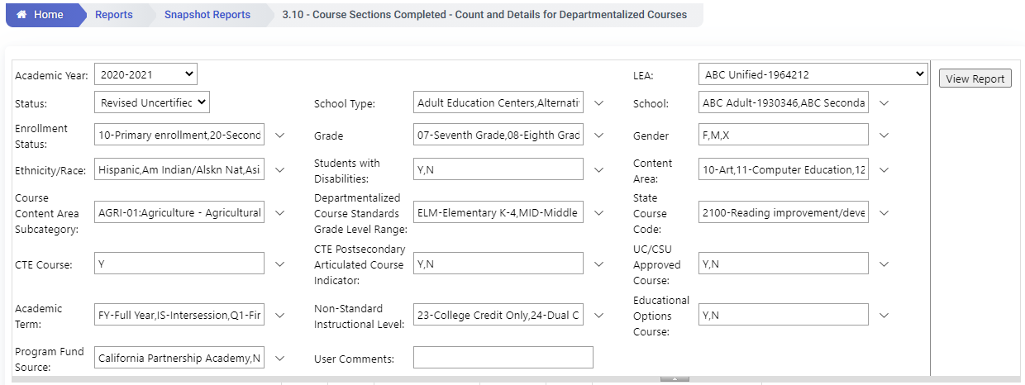
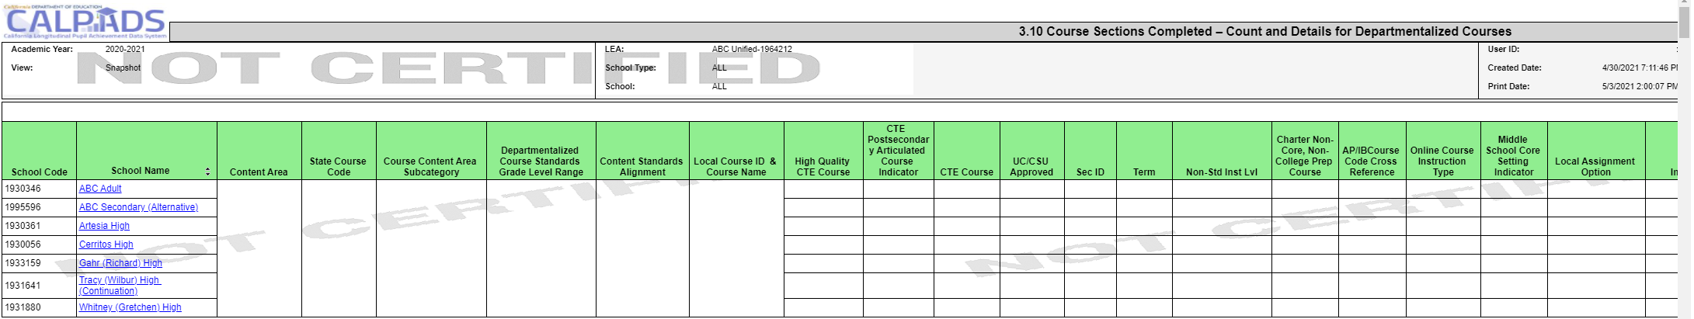
EOY 2 - Reviewing CTE Data
Review Report 3.10 - Course Sections Completed - Count and Details for Departmentalized Courses
The report should be requested twice with different filters.
To find college credit courses and Leadership/Military Science in the 9x series select the State Course codes of 9020, 9082, 9096, 9120, 9154, 9200, 9227, 9273, 9303, 9358, 9373
To find the CTE courses with the Non Standard Instructional codes of 23 and 24 select the CTE Course = Y and Non Standard Instructional Level to 23 and 24
Notes:
Reports the details of completed local course sections by State Course Code within Content Area as well as the number of students who completed each course section.
To find both sets of courses that satisfy the college credit and Leadership/Military Science the report should be request twice with different filters.
To find college credit courses and Leadership/Military Science in the 9x series select the State Course codes of 9020, 9082, 9096, 9120, 9154, 9200, 9227, 9273, 9303, 9358, 9373
To find the CTE courses with the Non Standard Instructional codes of 23 and 24 select the CTE Course = Y and Non Standard Instructional Level to 23 and 24

Slide 55
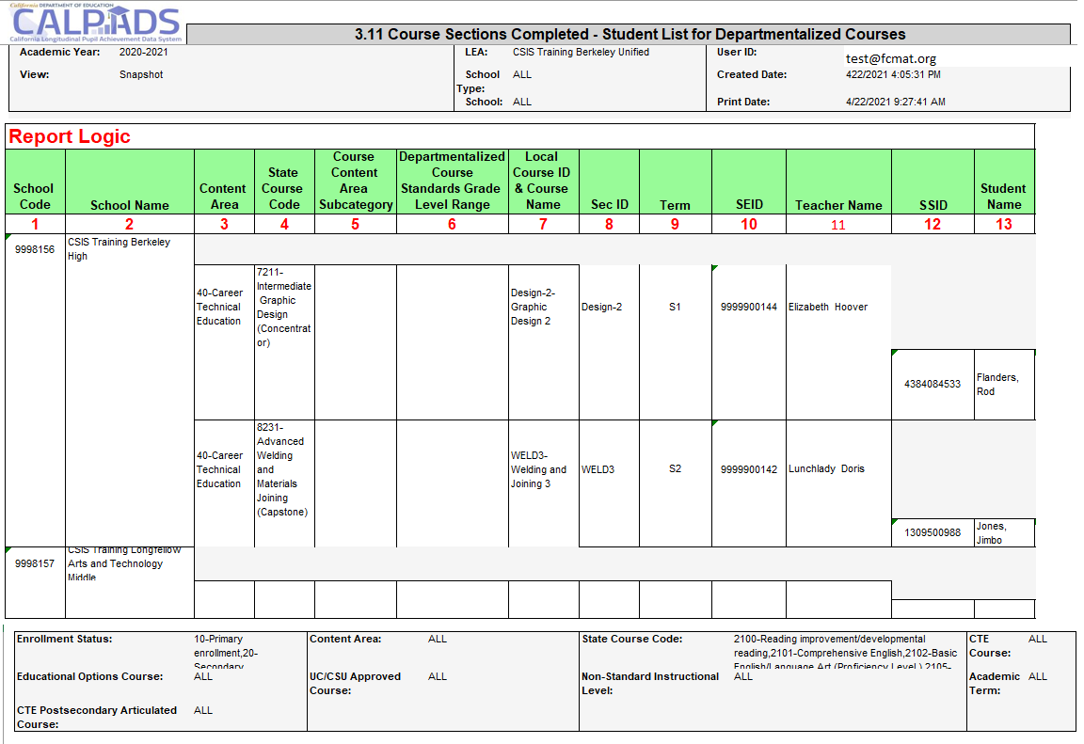
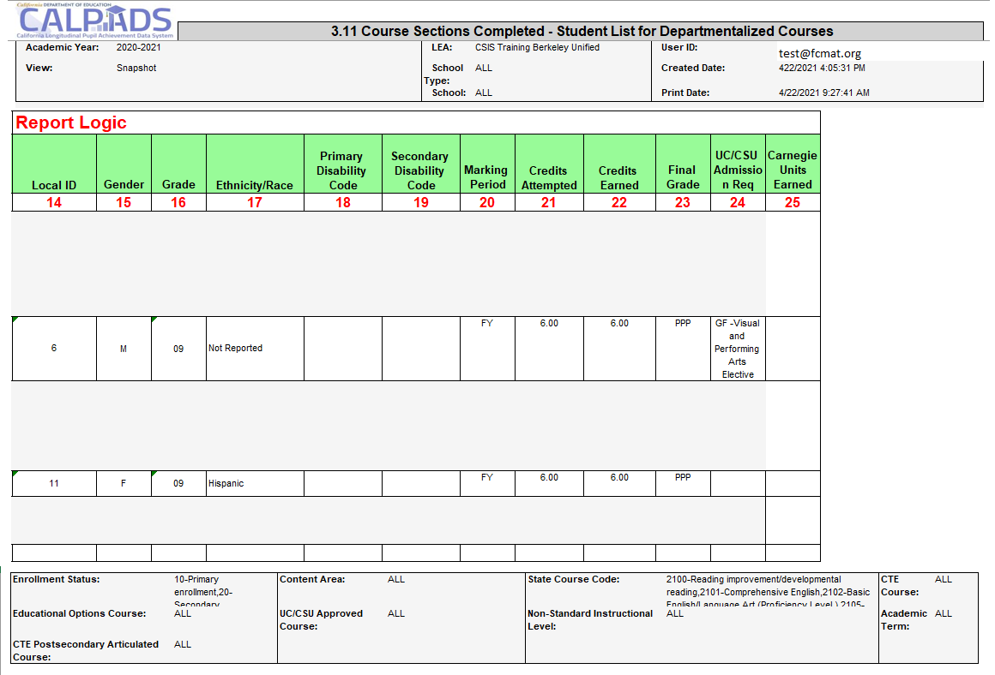
Report 3.11 Course Sections Completed
Student List for Departmentalized Courses
Notes:
Supporting Report 3.11 lists students in each completed course section by school with final completion information. This will help you to check and validate counts on report 3.9.

Slide 56
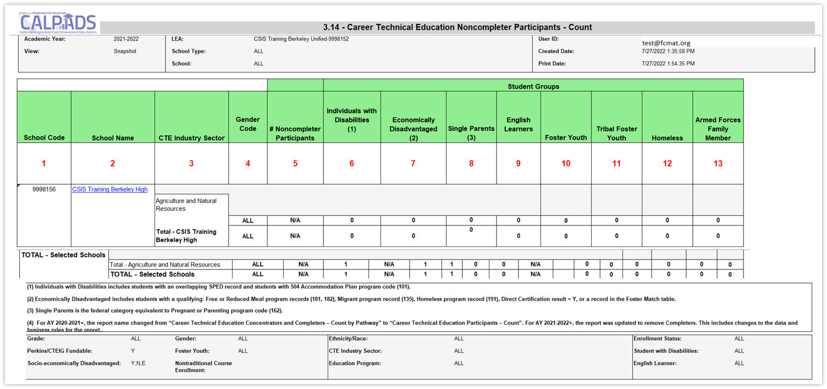
Report 3.14 CTE Noncompleter Participants – Count
Report defaults to counting Perkins/CTEIG fundable students in courses flagged with a High Quality CTE Course Indicator equal to Y. Switching the Perkins/CTEIG Fundable filter to ALL will include all other CTE courses not flagged.
Notes:
Report 3.14 counts the total number of CTE Non-completer Participants by Industry Sector, CTE Course at the school level and High Quality CTE Course. School level data is also aggregated at the LEA level. The number of participants within each Core Indicator group are also counted. The report defaults to counting Perkins/CTEIG fundable students. These students are in non-capstone CTE courses flagged with a High Quality CTE Course Indicator equal to Y that require the course be part of a CTE Pathway and are taught by a CTE-credentialed teacher.

Slide 57
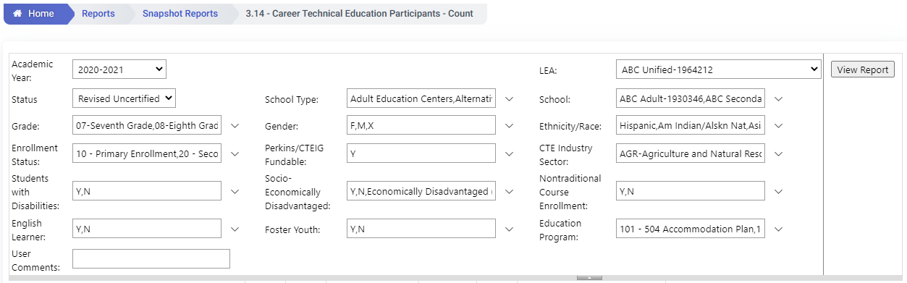
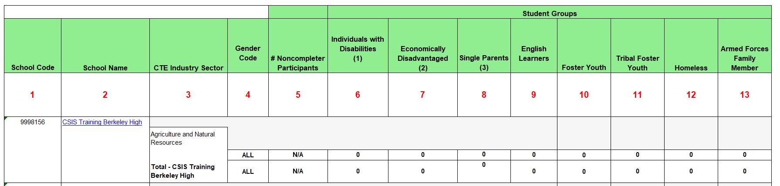
EOY 2 - Reviewing CTE Data
Review Report 3.14 Career Technical Education Noncompleter Participants – Count
Set Perkins/CTEIG Fundable to ALL to capture all students. Otherwise, it will default to courses only flagged a HQ CTE.
Filter for other specific sub-groups that comprise the core indicators (optional)
Notes:
Report 4.14 counts the total number of CTE Noncompleter Participants by CTE Course at the school level, by gender. School level data is also aggregated at the LEA level. The number of Noncompleter Participants within each Core Indicator group are also counted.

Slide 58
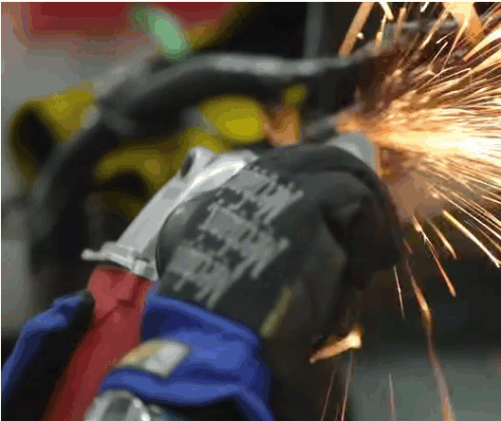
CTE Core Indicators
Individuals with Disabilities
Economically Disadvantaged: includes students with a qualifying: Free or Reduced Meal program record (181, 182), Migrant program record (135), Homeless program record (191), Direct Certification result = Y, or a record in the Foster Match table
Single Parents: is the federal category equivalent to Pregnant or Parenting program code (162)
Non-traditional Gender: gender less commonly associated with a field
Notes:
The core indicators listed on reports 3.14 and 3.15 are part of a students profile. Single parents and Individuals with Disabilities come from program records, while the Economically Disadvantage sub-group is a combination of program or student demographic information.

Slide 59
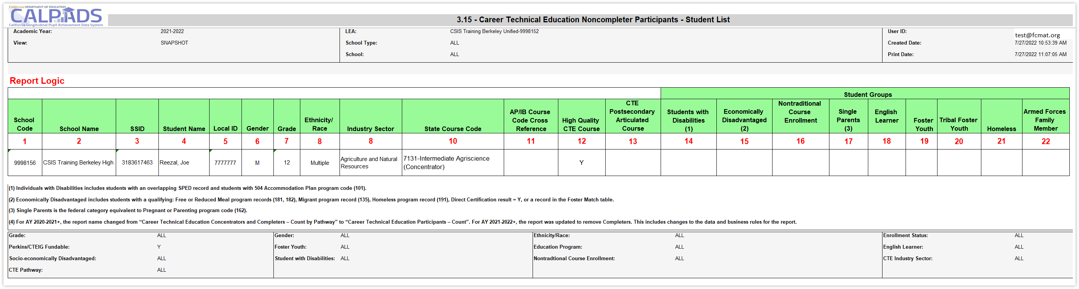
Report 3.15 CTE Noncompleter Participants– Student List
Report defaults to counting Perkins/CTEIG fundable students in courses flagged with a High Quality CTE Course Indicator equal to Y. Switching the Perkins/CTEIG Fundable filter to ALL will include all other CTE courses not flagged.
Notes:
Report 3.15 lists Career Technical Education (CTE) Participants and the Pathway they are pursuing, as well as completers if applicable. Report 3.15 provides the core indicators mentioned on the previous slide for these students.

Slide 60
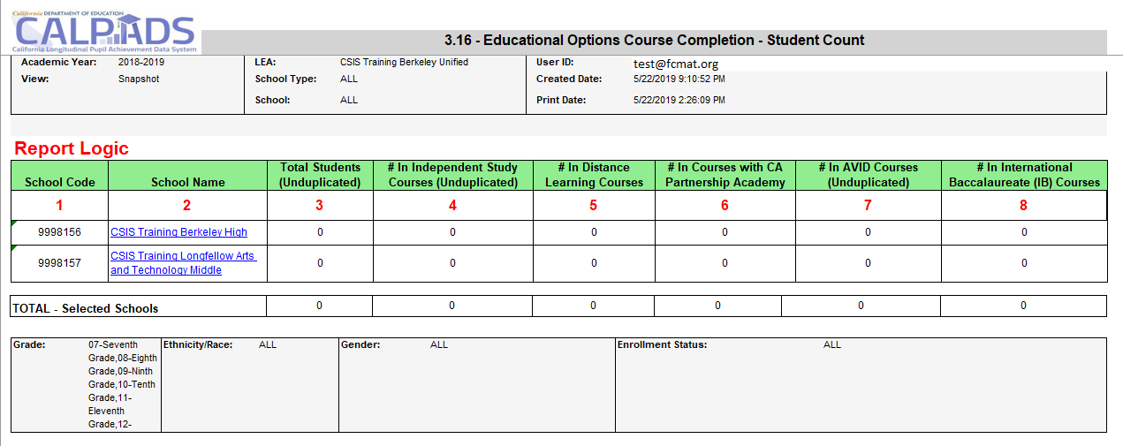
Report 3.16 – Educational Options Course Completion
Student Count
Notes:
Reports the number of students who have completed Educational Options courses during the Report Period.

Slide 61
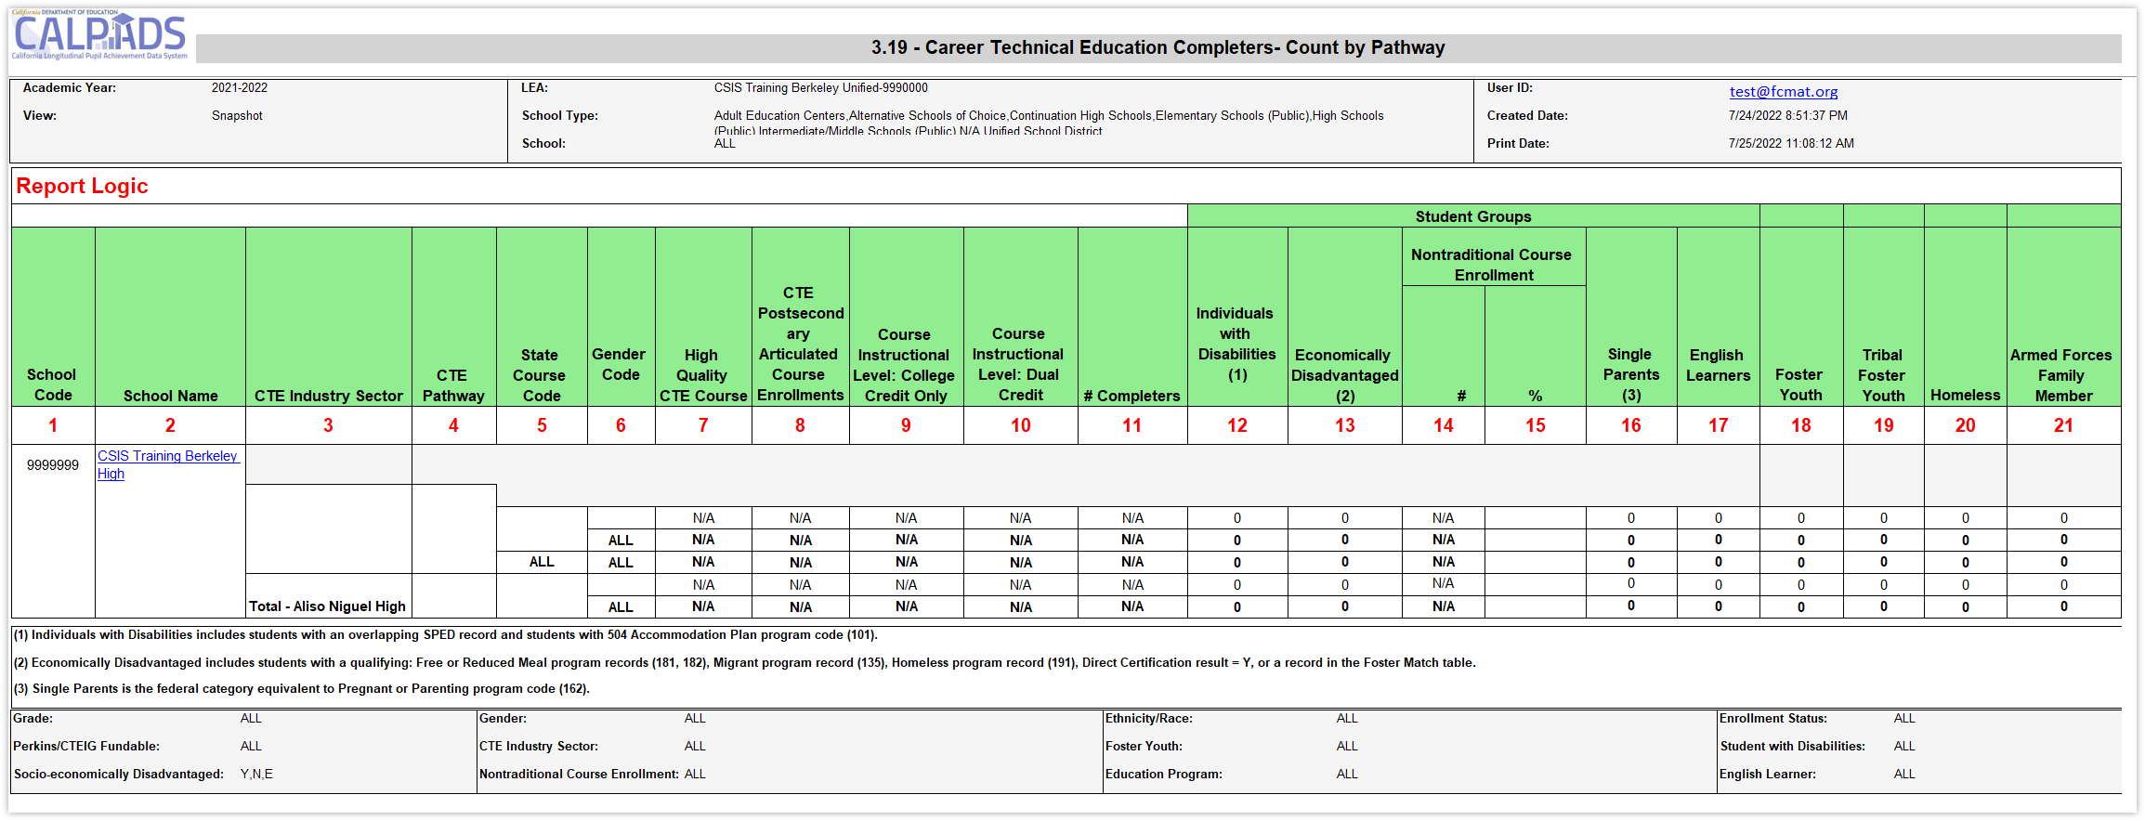
Report 3.19 CTE Completers – Count by Pathway
*NEW* in AY2023-2024: report 3.19 restricted to grades 9 -12
Notes:
Reports the total number of CTE Completers by Pathway at the school level, by gender. School level data is also aggregated at the LEA level. In addition, the number of Completers within each Core Indicator group are counted.
Students and Student Data to be Included:
Qualifying Enrollment:
Enrollment at a school any time during the Report Period
Enrollment Status Code = Primary (10), Secondary (20), or Short-Term (30)
Default Grade Level = 09-12 and US
Qualifying Data:
CTE Completer - See CALPADS Glossary: CTE Completer
CTE Course – See CALPADS Glossary: CTE Course
Use CTE Pathway Code and CTE Pathway Completion Academic Year ID from SCTE file. Use Valid Code Combos, Pathway-Ind Sector to select Industry Sector
Course completion record (CRSC) must map to a state course code within the pathway code reported from SCTE file in order for the student to be counted as a completer.
Student Data Rules, if applicable to report:
A student may have more than one CTE Pathway Code for the Reporting Year. All SCTEs are examined to determine the number of unique CTE Pathway Codes for each student. For each unique CTE Pathway Code value where the Enrollment Period overlaps the Reporting Year of the SCTE containing the CTE Pathway Code (Field 11.13) and the associated CTE Pathway Completion Academic Year ID (if exists), count the student in that Pathway. Specific/Exception rules:
A student who has different CTE Pathways (SCSC & SCTE) at the same school during the Reporting Period should be counted for each CTE Pathway.
A student who has the same CTE Pathway (SCSC & SCTE) at the same school during the Reporting Period should only be counted once for that CTE Pathway.
At the school level, a student who has the same or different CTE Pathways (both schools hold a SCSC & SCTE) for two different schools within the same LEA during the Reporting Period should be counted for each CTE Pathway (count in both schools).
At the school level, a student who has an SCSC at one school and SCTE at one school during the Reporting Period (within the same Reporting LEA and for the same SCTE Pathway), the student should only count once at the school where the student is primarily enrolled.
In the case where the student has two primary enrollments during the Reporting Period, and one school holds the SCSC and one school holds the SCTE, the school where the student took the Capstone course (SCSC/CRS) should receive the Completer count.
The total for selected schools (LEA level) should represent an unduplicated count of students across the LEA identified as CTE Completers.
Only students who have completed a CTE course and who have an associated SCTE record should be included in this report.
For counting within a Core Indicator, unduplicate at the State Course Code and School level.
For Nontraditional Course Enrollment only, count students where student gender = gender specified in CTE Non-Traditional Gender for State Group Course Code in each course for which a nontraditional gender has been established.

Slide 62
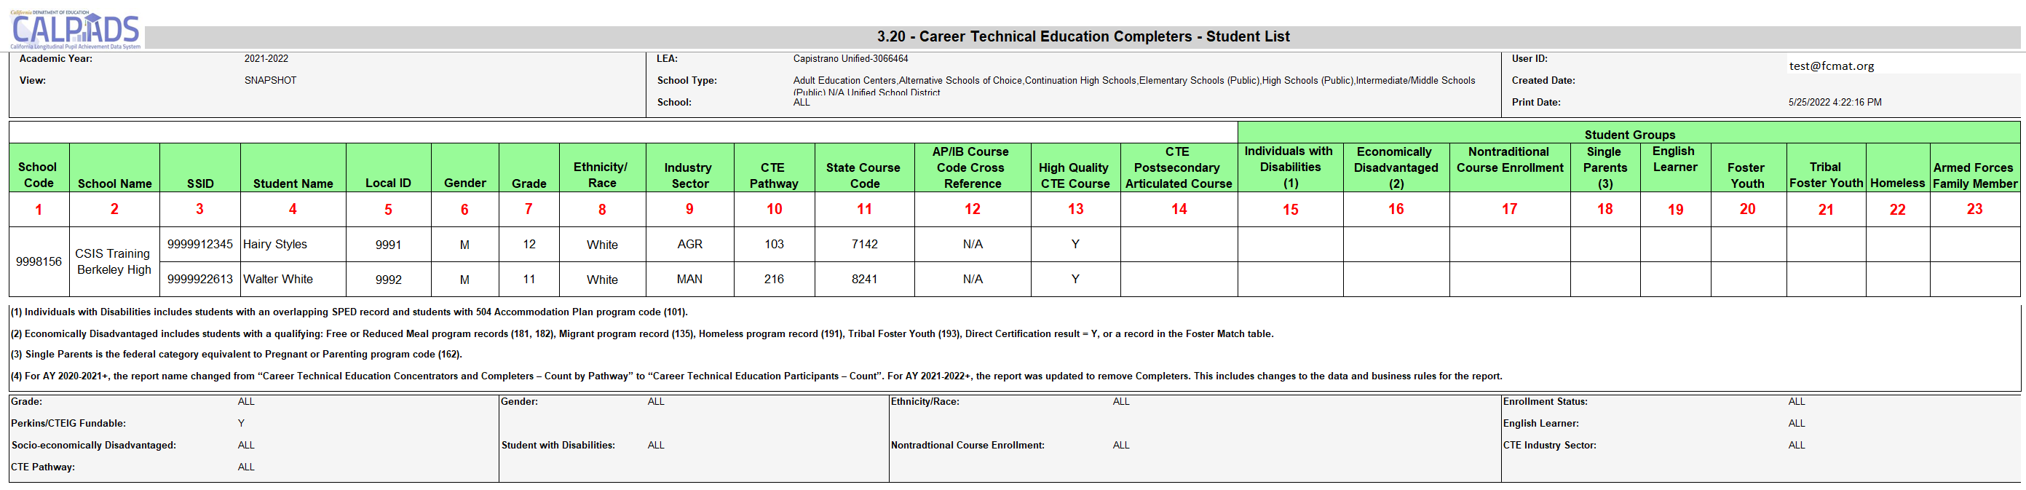
Report 3.20 - Career Technical Education Completers - Student List
Lists Career Technical Education (CTE) Completers and the Pathway they are pursuing. Also provides core indicators on these students.
*Starting AY2023-2024: report 3.20 restricted to grades 9 -12
Notes:
Reports the list of student Completers by Pathway at the school level, by gender. School level data is also aggregated at the LEA level. In addition, the number of Completers within each Core Indicator group are counted.
Students and Student Data to be Included:
Qualifying Enrollment:
Enrollment at a school any time during the Report Period
Enrollment Status Code = Primary (10), Secondary (20), or Short-Term (30)
Default Grade Level = 09-12 and US
Qualifying Data:
Completer - See CALPADS Glossary: CTE Completer
CTE Course – See CALPADS Glossary: CTE Course
Use CTE Pathway Code and CTE Pathway Completion Academic Year ID from SCTE file. Use Valid Code Combos, Pathway-Ind Sector to select Industry Sector
Course completion record (CRSC) must map to a state course code within the pathway code reported from SCTE file in order for the student to be counted as a completer.
Student Data Rules:
A student may have more than one CTE Pathway Code for the Reporting Year. All SCTEs are examined to determine the number of unique CTE Pathway Codes for each student. For each unique CTE Pathway Code value where the Enrollment Period overlaps the Reporting Year of the SCTE containing the CTE Pathway Code (Field 11.13) and the associated CTE Pathway Completion Academic Year ID (if exists), count the student in that Pathway. Specific/Exception rules:
A student who has different CTE Pathways (SCSC & SCTE) at the same school during the Reporting Period should be counted for each CTE Pathway.
A student who has the same CTE Pathway (SCSC & SCTE) at the same school during the Reporting Period should only be counted once for that CTE Pathway.
At the school level, a student who has the same or different CTE Pathways (both schools hold a SCSC & SCTE) for two different schools within the same LEA (no overlapping enrollment) during the Reporting Period should be counted for each CTE Pathway (count in both schools).
At the school level, a student who has an SCSC at one school and SCTE at one school during the Reporting Period (within the same Reporting LEA and for the same SCTE Pathway), the student should only count once at the school where the student is primarily enrolled.
In the case where the student has two primary enrollments during the Reporting Period, and one school holds the SCSC and one school holds the SCTE, the school where the student took the Capstone course (SCSC/CRS) should receive the Completer count.
Only one record per State Course Code per SSID should populate. If the student is counted in multiple pathways (in 3.19) as listed in the previous section, each of those records should show up on this report.
Only students who have completed a CTE course and who have an associated SCTE record should be included in this report.
For counting within a Core Indicator, unduplicate at the State Course Code and School level.
For Nontraditional Course Enrollment only, count students where student gender = gender specified in CTE Non-Traditional Gender for State Group Course Code in each course for which a nontraditional gender has been established.

Slide 63
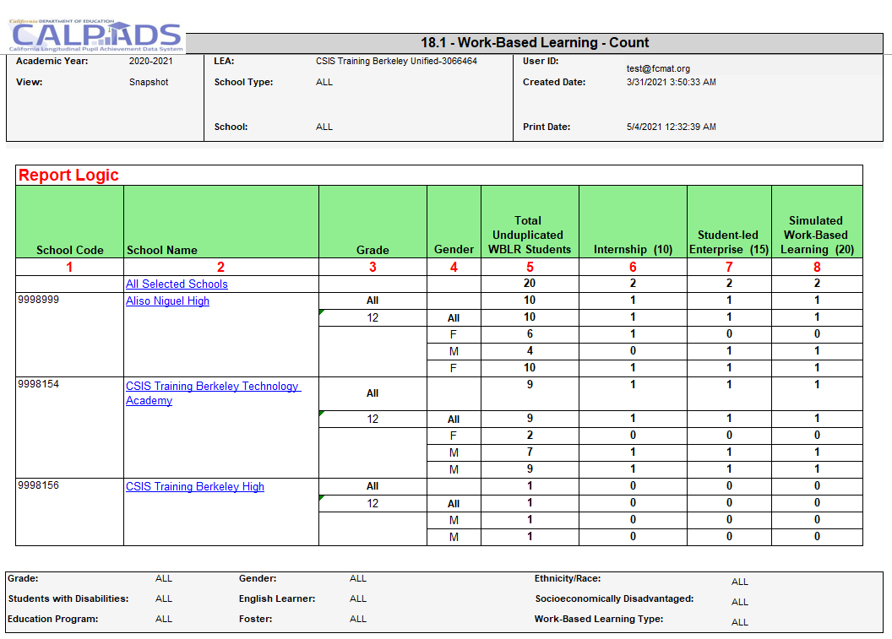
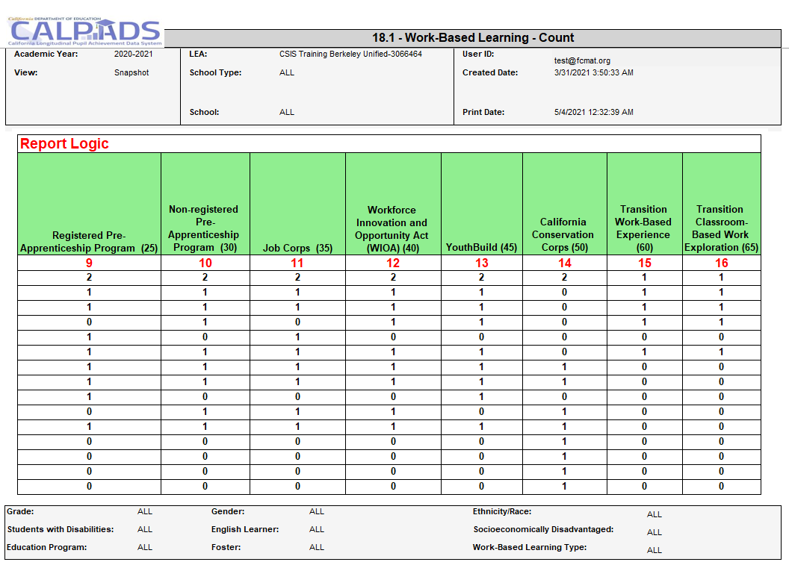
Report 18.1 Work-Based Learning - Count
Notes:
Reports the total number of students with a Work-Based Learning record and the count for each Work-Based Learning Type.
Students and Student Data to be Included: Students who have a qualifying enrollment and associated Work-Based Learning (WBLR) record:
Qualifying Enrollment:
Enrollment at the School of Attendance that overlaps the selected Academic Year
Enrollment Status Code = Primary Enrollment (10), Secondary Enrollment (20), Short-Term Enrollment (30)
Grade Level = 9, 10, 11, or 12
Qualifying Work-Based Learning:
Work-Based Learning records in the selected Academic Year at the School of Attendance from the Enrollment record
Rules specific to this report:
Student Information (SINF) data reported or used for selecting student subgroups (e.g. Race/ethnicity, Gender, etc.) are selected from the most recent SINF record that overlaps the qualifying enrollment.
Student Program (SPRG) data used for selecting student subgroups (e.g., Homeless, Migrant, etc.) are selected from the most recent SPRG record that overlaps the qualifying enrollment record.
Student English Language Acquisition Status (SELA) data reported or used for selecting student subgroups (e.g. English Learner) are selected from the most recent SELA record that overlaps with the qualifying enrollment.
Foster: see CALPADS Glossary for Foster Program Eligible for criteria.
Status options to be Included:
Certified – If the selected LEA has a certified snapshot, present this option of the certified revision in Status dropdown
Revised Uncertified– Present most recent revision that is not already Certified, In Review Uncertified, or Decertified
In Review Uncertified-The revision that is manually flagged by the LEA as currently under review for potential certification.
Decertified- If the selected LEA has any decertified revisions, and no certified revisions, this option will be available in the Status dropdown to render the report with the most recent decertified revision.

Slide 64
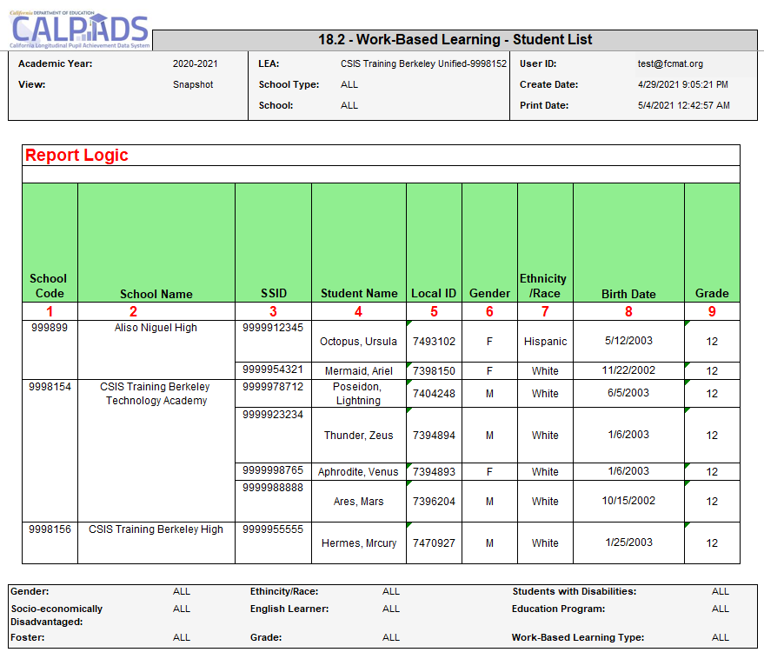
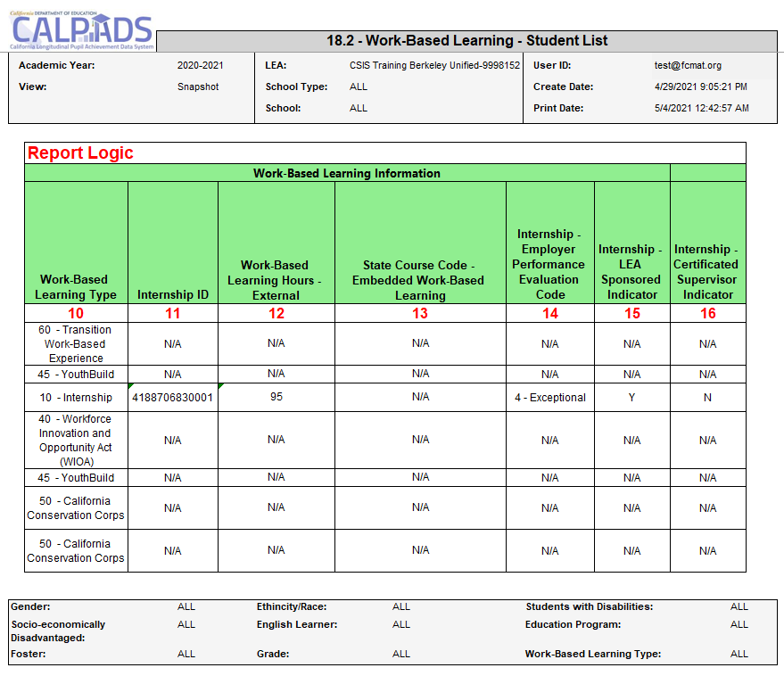
Report 18.2 Work-Based Learning – Student List
Notes:
Reports the details for students with a Work-Based Learning record.
Students and Student Data to be Included: Students who have a qualifying enrollment and associated Work-Based Learning (WBLR) record:
Qualifying Enrollment:
Enrollment at the School of Attendance that overlaps the selected Academic Year
Enrollment Status Code = Primary Enrollment (10), Secondary Enrollment (20), Short-Term Enrollment (30)
Grade Level = 9, 10, 11, or 12
Qualifying Work-Based Learning:
Work-Based Learning records in the selected Academic Year at the School of Attendance from the Enrollment record
Rules specific to this report:
Student Information (SINF) data reported or used for selecting student subgroups (e.g. Race/ethnicity, Gender, etc.) are selected from the most recent SINF record that overlaps the qualifying enrollment.
Student Program (SPRG) data used for selecting student subgroups (e.g., Homeless, Migrant, etc.) are selected from the most recent SPRG record that overlaps the qualifying enrollment record.
Student English Language Acquisition Status (SELA) data reported or used for selecting student subgroups (e.g. English Learner) are selected from the most recent SELA record that overlaps with the qualifying enrollment.
Foster: see CALPADS Glossary for Foster Program Eligible for criteria.
Status options to be Included:
Certified – If the selected LEA has a certified snapshot, present this option of the certified revision in Status dropdown
Revised Uncertified– Present most recent revision that is not already Certified, In Review Uncertified, or Decertified
In Review Uncertified-The revision that is manually flagged by the LEA as currently under review for potential certification.
Decertified- If the selected LEA has any decertified revisions, and no certified revisions, this option will be available in the Status dropdown to render the report with the most recent decertified revision.

Slide 65

Wrap Up
Key Points, Resources and Support

Slide 66

Submission
Summary
EOY 2 requires the SDEM, CRSC, SCSC, SCTE and WBLR records be posted
Course completion (CRSC) data is required for students in departmentalized classroom settings in grades 9–12 attending traditional schools. Optional for 7-8 grades
Grades, credits attempted, and credits earned are required for grade levels 9–12. Only grades are required for 7–8 should you opt to report.
Submit student course completion (SCSC) data from all official grading periods for the school year
LEAs identify CTE participants by submitting course completion (SCSC) data
SCTE records must only be submitted for CTE Pathway completers who finished the capstone course in the current academic year.
One-Year Grad and Completers are now certified in EOY 2
Some key points to remember
Notes:
READ SLIDE
EOY 2 requires the SDEM, CRSC, SCSC, SCTE and WBLR records be posted
Course completion (CRSC) data is required for students in departmentalized classroom settings in grades 9–12 attending traditional schools. Optional for 7-8 grades
Grades, credits attempted, and credits earned are required for grade levels 9–12. Only grades are required for 7–8.
Submit student course completion (SCSC) data from all official grading periods for the school year
LEAs identify CTE participants by submitting course completion (SCSC) data
SCTE records must only be submitted for CTE Pathway completers who finished the capstone course in the current academic year.

Slide 67
What are the data used for?
State
  DataQuest
  California Dashboard
  SARC
  Ed-Data
Federal
  EDFacts file submissions and the Consolidated State Performance Report (CSPR)
  Migrant Student Information Exchange (MSIX) - Course Completion, Carnegie Unit
  Titles VI & IX reports for the Civil Rights Act of 1964
  Carl Perkins Reporting
  (CTE Participants and Completers)
  Section 1418 of the Individuals with Disabilities Education Act (IDEA) 2004 of the federal statutes (Title 20 USC Chapter 33), Individual with Disabilities Education Act (IDEA)
Notes:
At the state level, EOY 2 data are published on Data Quest and the CA School Dashboard, as well as the School Accountability Report Card (SARC) and Ed-Data.
At the federal level, EOY 2 data are sued for the Consolidated State Performance Report (CSPR), Migrant Student Information Exchange, Title 6 and Title 9 funding reports for the Civil Rights Act of 1964, Carl Perkins and CTEIG funding, and Individuals with Disabilities Education Act (IDEA) compliance.

Slide 68
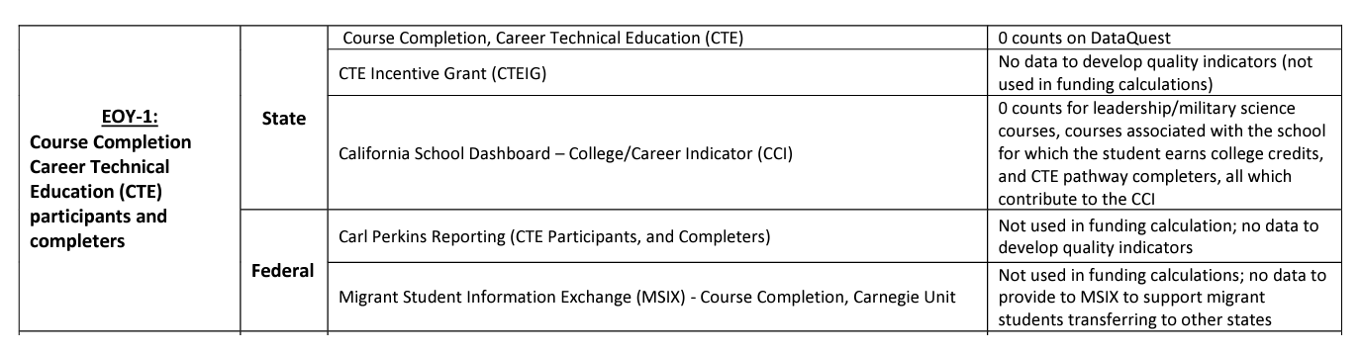
Impact of not certifying EOY 2
Resource: https://csis.fcmat.org/document/CALPADSResources/How_CALPADS_Data_are_Used_and_Consequence.pdf
Notes:
This slide shows what data is submitted for EOY and what it is used for both at the state and federal levels. It also shows what impact it will have if your LEA does not certify EOY.
Reminder – Please note that your EOY 21 data submission is one of the data sources for some of the indicators of the Ca. School Dashboard. Therefore, it is becoming even more critical to complete and certify the EOY submissions on time.

Slide 69
Suggested Milestones - EOY 2 - 2025-2026
Now – 5/5
Complete Data Population in local SIS
Now – 7/3
Submit and post files. Review IVR and Data Discrepancy errors and reconcile as needed.
7/4 – 8/3
Resolve Certification and Data Discrepancy errors. Review snapshot reports and update records as needed
0
8/3
Recommended Date for Zero Errors
Aug 3, 2026
Recommended date for zero errors
8/4– 8/10
Send reports to local data stewards, site leaders and administrators for approval (Send earlier if possible)
8/11 – 8/17
LEA Approve by Certification Deadline
8/17
Final Deadline (No Amendment Window)
Notes:
This slide contains our suggested EOY milestones

Slide 70




Resources
Here are some important resources related to EOY reporting.
  https://csis.fcmat.org/csis-training/
https://www.youtube.com/c/CSISCALPADSTrainingChannel
https://documentation.calpads.org/Support/References
https://www.cde.ca.gov/ds/sp/cl/systemdocs.asp
https://csis.fcmat.org/resources
Notes:
The CSIS LMS, Bridge, the YouTube Channel for CSIS Training, the CALPADS User Manual, the System Documentation page, and the CSIS website are all fantastic resources and locations to find support. The CSIS YouTube Training Channel houses all training recordings, including our orientation and basics, Data Population, Reporting and Certification, advanced, and Skill Building courses.

Slide 71

Support
http://www2.cde.ca.gov/calpadshelp/default.aspx
Web
calpads-support@cde.ca.gov
Email
916-325-9210
Phone
https://csis.fcmat.org/ListServ
https://www.cde.ca.gov/ds/sp/cl/listservs.asp
You can get help through these channels.
Listserv
Notes:
If you need to submit a support request, the CALPADS web form is the fastest way to reach out and talk to the service desk. The web form is located under “Help” in the CALPADS web portal, there are service request links in the CALPADS user manual, and you can submit a service request through the CSIS website. In addition to the web form, you can email or telephone the support desk. Please be aware that email and telephone support are not instantaneous, and the web form is the fastest way to obtain support. However, regardless of how you contact the support desk, we will assist you.
Please be aware the there is a CSIS FCMAT listserv which allows you to communicate with CALPADS professionals, whether they be other LEAs, CSIS Client Services team, or members of the CDE. This is a two-way form of communication and adds great value to your support because LEAs using similar local systems can resolve problems related to those systems by direct communication. Also be aware that not pictured here is the CDE listserv for CALPADS. Importantand timely communications are provided to LEAs through the CALPADS Listserv.

Slide 72
Feedback
I have a question…
“
”
Please complete survey…
https://bit.ly/2MXsECg
“
”
Notes:
Please take the time to complete our training survey. Your responses assist in improving our trainings.
We review these surveys on a regular basis—in fact due to LEAs’ suggestions we have changed our survey, have included more visual aids, and demonstrations in our trainings.
If you experience any technical difficulty with accessing the survey, please try the alternative long URL:
Long URL: https://forms.office.com/Pages/ResponsePage.aspx?id=k1b3XxqV6E2E3dWxsESwNX2FYi3dRZNNt8LpvkF_wmhUNVRLOVBDVkoySE01UTJSRk42VTlaUUFIQi4u
Short URL: https://bit.ly/2MXsECg
Thank you for providing us the opportunity to evaluate our trainings.

Slide 73

Thank You
CSIS Training Team
916-325-9200
csistraining@fcmat.org
https://csis.fcmat.org/

